Slide 1

Social entrepreneurship and work integration
Eliška Hudcová
Jabok

Slide 2
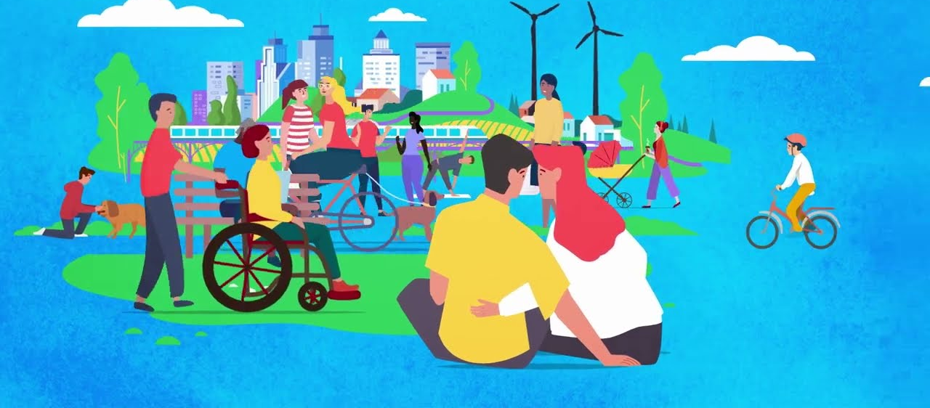
Summary of the last meeting…

Slide 3
Social entrepreneurship
Social entrepreneurship is business activity that benefits society and the environment. It plays an important role in local development and often creates employment opportunities for people with health, social or cultural disadvantages. Profits are largely used to further develop the social enterprise. Making a profit is as important to a social enterprise as increasing public benefit.

Slide 4
Social enterprise
A social enterprise is defined as a "social enterprise entity", i.e. a legal entity established under private law or a part thereof or a natural person that complies with the principles of a social enterprise. A social enterprise pursues a public benefit objective which is formulated in its founding documents. It is founded and developed on the concept of the so-called triple benefit - economic, social and environmental.

Slide 5
Social enterprise principles
Social benefit
socially beneficial objective of employment and social inclusion of disadvantaged people in the labour market as formulated in the founding documents
participation of employees and members in the direction of the enterprise
Economic benefit
any profits are used preferably for the development of the social enterprise and/or for the fulfilment of its socially beneficial objectives
independence (autonomy) in managerial decision-making and management from external founders or founders
at least a minimum share of revenues from the sale of products and services in total revenues

Slide 6
Social enterprise principles
Environmental benefit
taking into account the environmental aspects of production and consumption and/or carrying out activities that benefit the environment
Local benefit
meeting the needs of the local community and local demand
the use of local resources as a priority
social enterprise cooperation with local actors

Slide 7
Social benefit – inclusion in the labour market
Universal Declaration of Human Rights (1948), Article 23
Everyone has the right to work, to free choice of employment, to just and favourable conditions of work and to protection against unemployment.
Everyone, without any discrimination, has the right to equal pay for equal work.
Everyone who works has the right to just and favourable remuneration ensuring for himself and his family an existence worthy of human dignity, and supplemented, if necessary, by other means of social protection.
Everyone has the right to form and to join trade unions for the protection of his interests.

Slide 8
Social benefit – inclusion in the labour market
Convention on the Rights of Persons with Disabilities (2006), Article 27
https://www.ohchr.org/en/instruments-mechanisms/instruments/convention-rights-persons-disabilities
States Parties recognize the right of persons with disabilities to work, on an equal basis with others; this includes the right to the opportunity to gain a living by work freely chosen or accepted in a labour market and work environment that is open, inclusive and accessible to persons with disabilities. States Parties shall safeguard and promote the realization of the right to work, including for those who acquire a disability during the course of employment, by taking appropriate steps…
States Parties shall ensure that persons with disabilities are not held in slavery or in servitude, and are protected, on an equal basis with others, from forced or compulsory labour.

Slide 9

What does it mean to be employed?

Slide 10
Benefits of employment
Regular wage/salary
Regular shared experience and contact with people outside the nuclear family
Achieving individual goals
Personal status and identity
Regular activity
Access to education, health, other services
Material benefits
Adequate housing
Participation in political and civic life

Slide 11
Employment and dependent work
Employment: performance of dependent work between employees and employers, employment relationship
Dependent work: relationship of employer's superiority and employee's subordination, according to the employer's instructions
Dependent work: performed for a wage, salary or remuneration for work, at the employer's expense and responsibility
Dependent work: performed exclusively in a basic employment relationship.

Slide 12
Employer and Employee
Employer: a person for whom a natural person has undertaken to perform dependent work in a basic employment relationship (legal entity, natural person, or state).
Employer is always a single legal entity. In one employment relationship, an employee has only one employer.
Employee: a natural person who is one of the participants in an employment relationship in which he or she has undertaken to perform dependent work for the employer, for which he or she is entitled to a wage or salary

Slide 13

Who is a person disadvantaged in the open labour market?

Slide 14
A person disadvantaged in the open labor market due to:
  Age
  Health
  Socioeconomic conditons
  Low or insufficient qualifications
  Insufficient practice

Slide 15
A person disadvantaged in the open labor market often struggles with:
Health problems and higher morbidity
Low work habits
Poor housing
Indebtedness, foreclosure
Lack of social support and social networks
Low-income
Inactivity

Slide 16
A person disadvantaged in the open labour market requires:
increased attention when performing work

Slide 17
Diverse forms of employment
Employee Sharing
Job Sharing
Casual Work
Mobile Work (home office)
Voucher-Based Work
Portfolio Work (a self-employed person who performs small-scale work for a large number of clients)
Group Employment (Uber, Wolt)
Collaborative Employment

Slide 18
Active employment policy
A set of tools and measures that contribute to the creation of new jobs and thus help alleviate the unfavorable situation of job seekers looking for new employment.
Employers can draw financial support in the form of various contributions.
The contributions are aimed primarily at supporting the employment of people who cannot find suitable employment in any other way due to their individual characteristics.

Slide 19
Different forms of supported work places
Socially useful jobs
Community service
Requalification
Integration workplace
Integration social enterprise
Work rehabilitation
Sheltered workplace
Integration social enterprise

Slide 20
Basic employer requirements
Willingness to take risks
Perseverance
Strong will
Strive to grow
High work commitment
Willingness to cooperate
Willingness to adapt
Organizational skills
Flexibility
Health
Qualifications
Patience
Values
Humanity
Solidarity
Goal

Slide 21
Psychosocial support
Identification of barriers to entry into the free labor market
absence of stable housing
debts, foreclosures
criminal history
low education and qualifications
Support tied to barriers
e.g. ensuring basic living needs - material needs, housing, debt resolution, mental and physical health, support for work skills

Slide 22
Individual planning
Meaningful solution to a difficult social situation
Individualised advisory tool for job seekers to whom the Labour office pays increased care
Definition of needs and specific steps for change
Determination of a schedule for the fulfillment of individual activities of the applicant, thanks to which the possibility of the applicant's employment increases

Slide 23
Other means of support
employee personal profile
job skills mapping
sufficient information about employment, operations, job description, duties and obligations
grading of apprenticeship - training
work assistant

Slide 24
Limits of Europe (2024)
https://vimeo.com/815597945/0c211765c1?share=copy
https://hypermarketfilm.cz/en/film/limits-of-europe/

