Slide 1
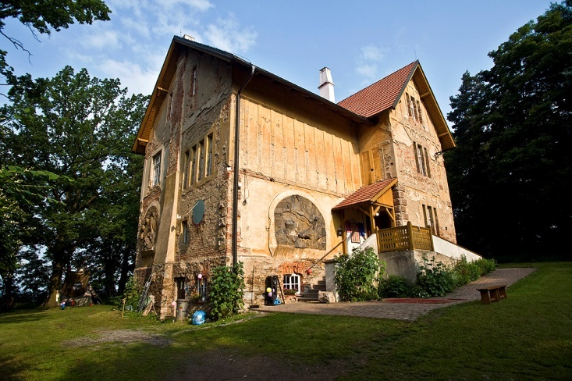
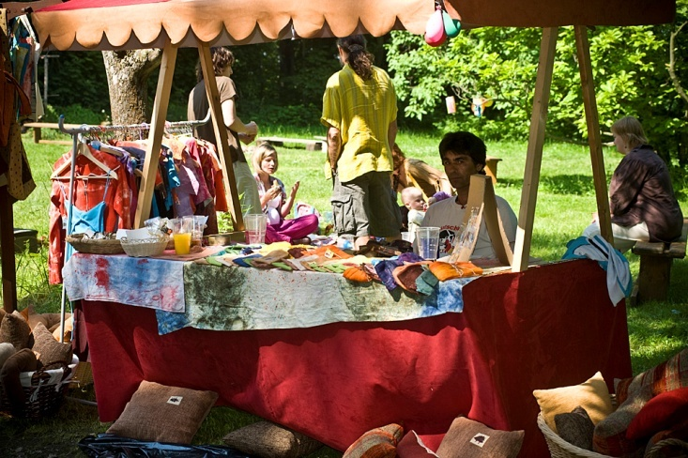
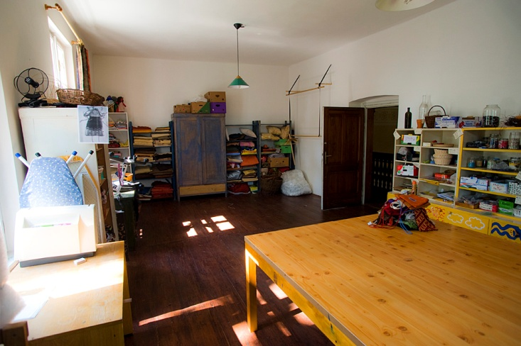
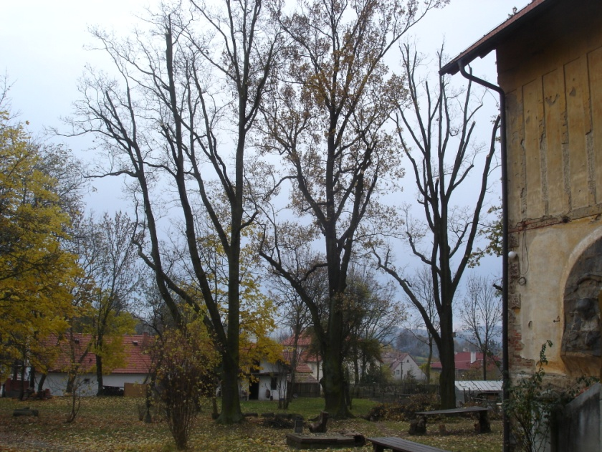
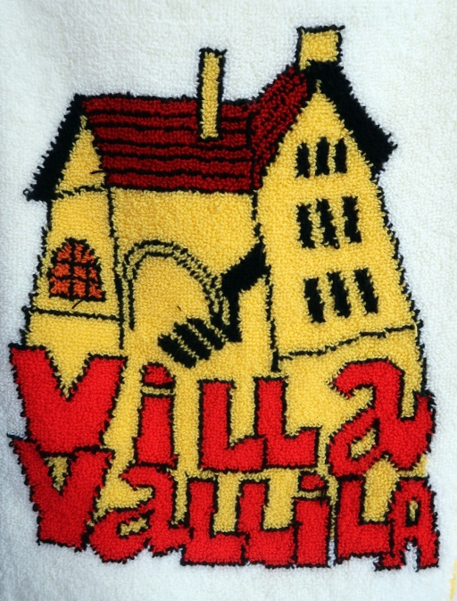
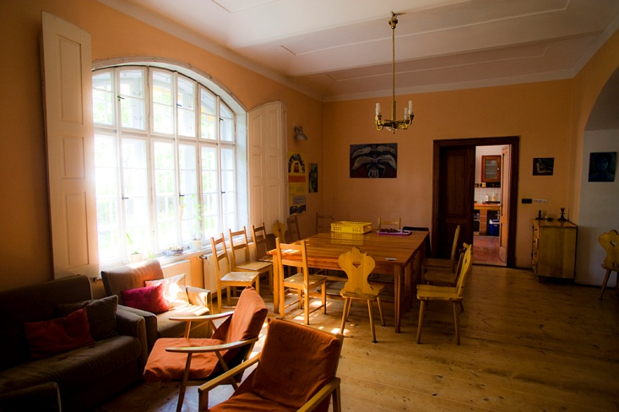
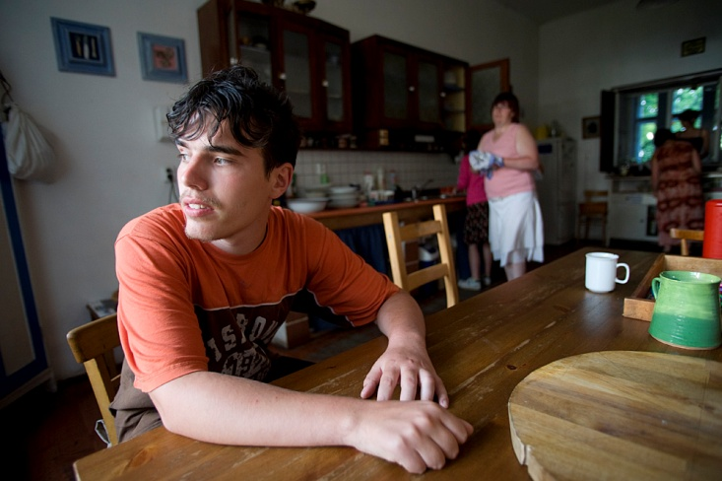

Slide 2
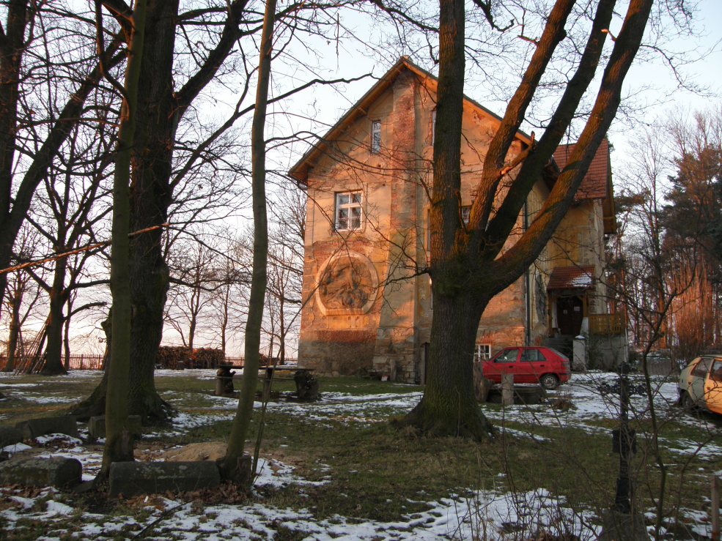
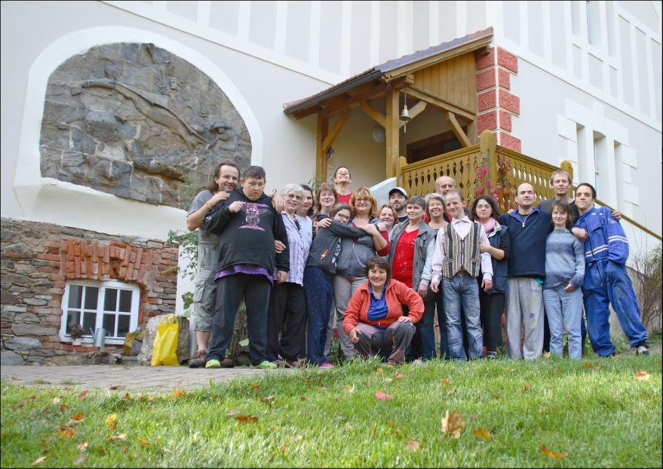
Villa Vallila
The civic association was founded in 1996 with the aim
to build and operate a community house in Červený Újezd near Votice as a home for people with disabilities.

Slide 3
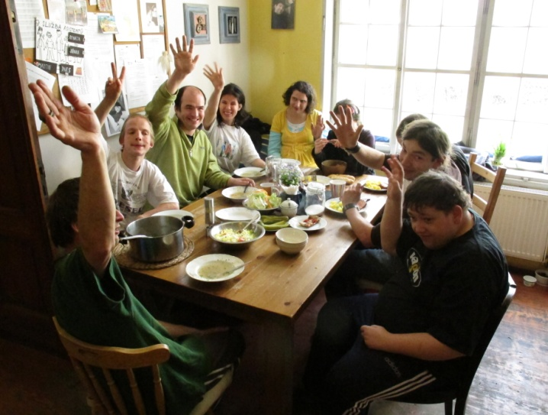
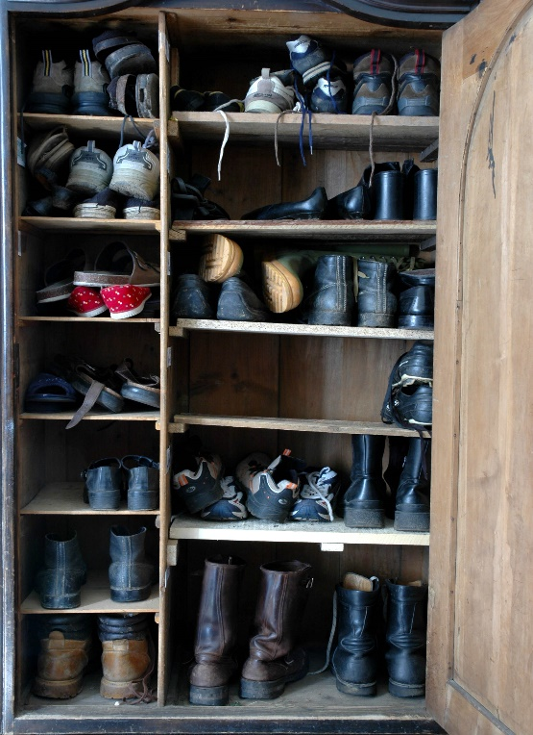
Who we are today in 2018
Target group:
young people with disabilities
and social disadvantages
Social services provider:
protected housing
respite services
social therapeutic workshop

Slide 4
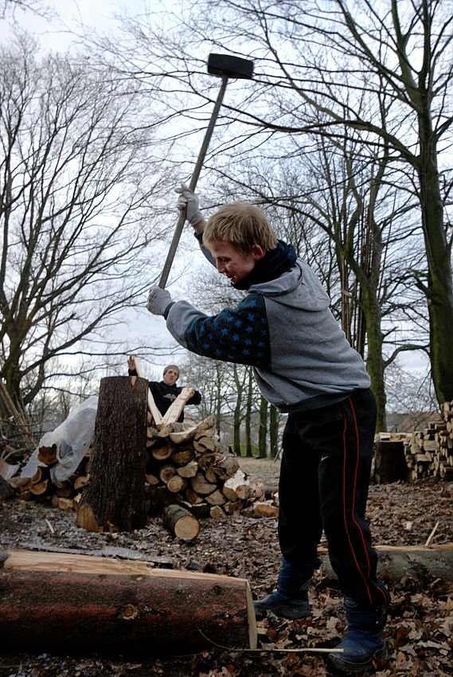
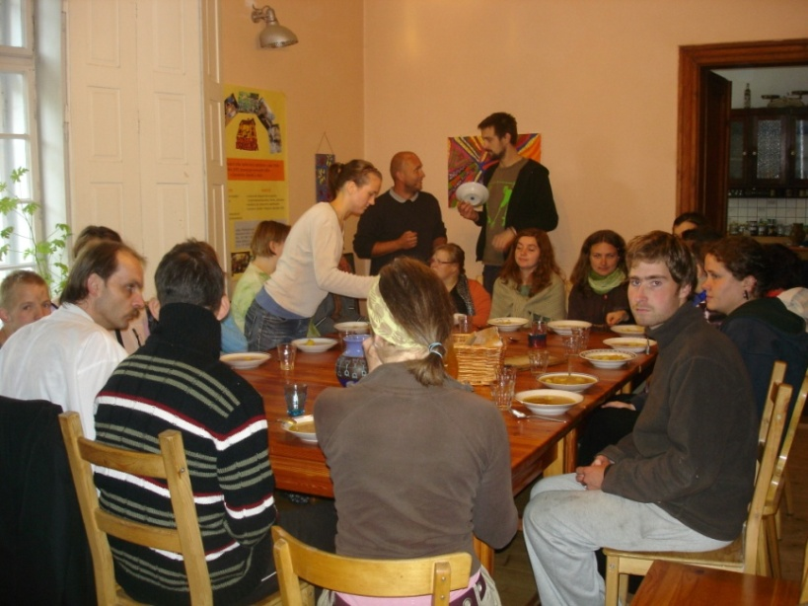
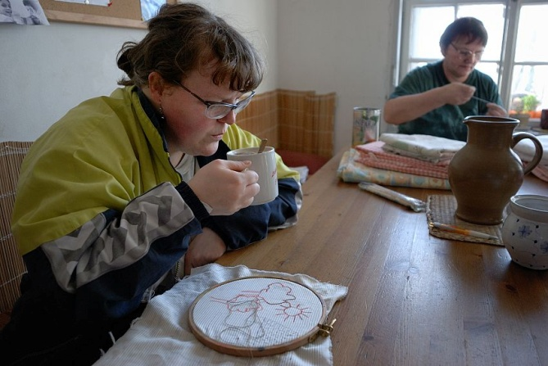
Our mission
To enable people with various handicaps to live full life in natural conditions of human community. In order to fulfil its vocation, Villa Vallila runs a community house in Červený Újezd near Votice.
To provide a support to core members of Villa Vallila for their integration into normal social and working environment.

Slide 5
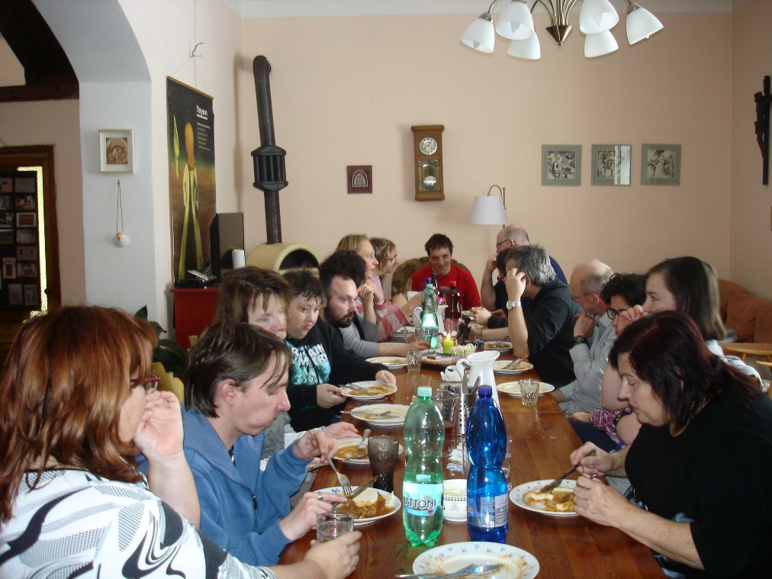
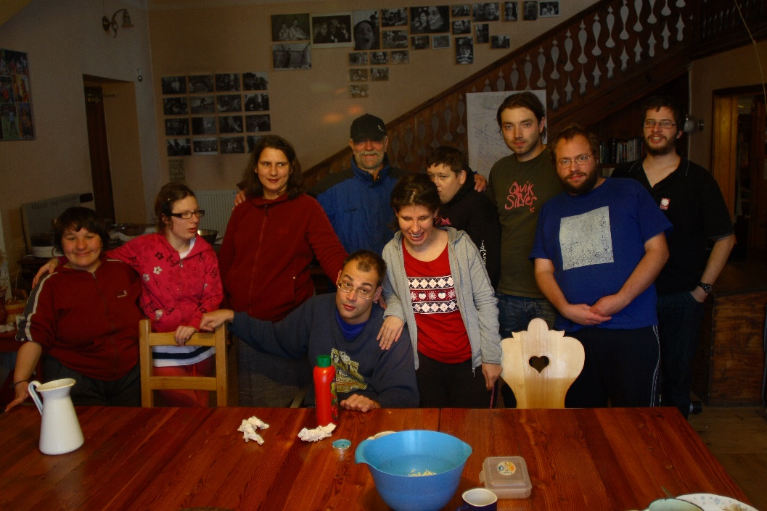
Our identity
Respecting and promoting the rights of the people with mental disabilities especially the right to dignified conditions, the right to home and the right to work engagement.
Improving the life of adult people with mental disabilities in the way of community life.
Recognizing the abilities of the people with „different“ mentality and to call attention to their valuable qualities. To support their meaningful integration through interpersonal relations.

Slide 6
History of Villa Vallila
1996 – 2001 Establishment of civic association, purchase of dilapidated building, reconstruction, commencement of operation
2002 – 2005 Opening a house for people with disabilities, registration of social services, establishment of a therapeutic farm, reconstruction of the attic
2006 – 2007 Construction of a sports ground, ergotherapeutic workshop, training kitchen - strengthening work and leisure activities of the house
2008 – 2009 Construction of separate shelters in a house under Villa

Slide 7
History of Villa Vallila
2010 – 2011 New clients, new sheepfold, new fences, new ideas, lack of funds
2012 – 2013 Initiating the plaster repair project - gradually the individual walls of the house; establishing contacts with Jean Vanier’s Archa International Movement - starting a new collaboration and trying to join this movement; new cooperation with Benedictus
2014 – 2015 Successful completion of plaster throughout the community building; the celebration of 50th anniversary of the founding of the Jean Vanier’s Archa
2016 – 2018 Formation of assistants, visits to Archa communities, regular community weekends; repair of František Bílek’s relief, built outdoor baking oven for pizza and bread, newly furnished therapeutic workshop, house furnished as suitable accommodation for rent

Slide 8
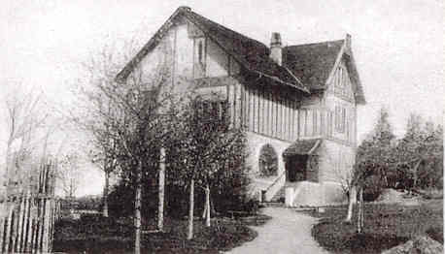
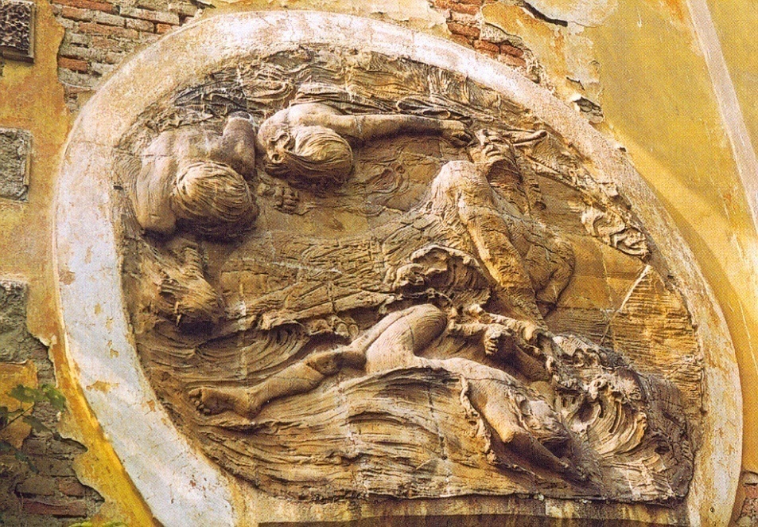
History of the house
Built at the beginning of the last century, the reliefs of František Bílek
Until 1949 the country house of a rich Prague family
Uninhabited since 1952 - leaving the owner with her husband (Finnish diplomat) from the Czechoslovakia
Bought in 1997 by civic association Villa Vallila

Slide 9
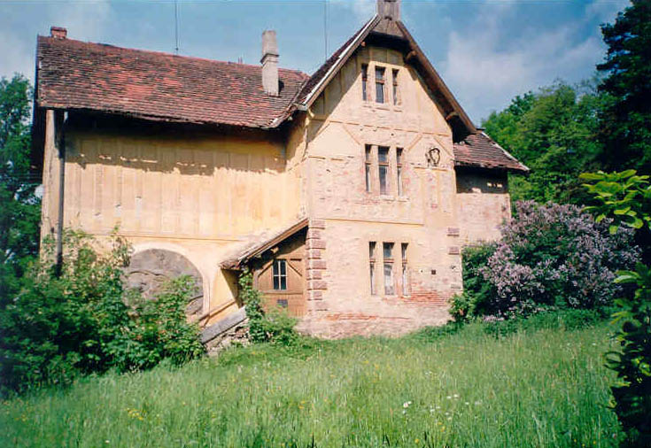
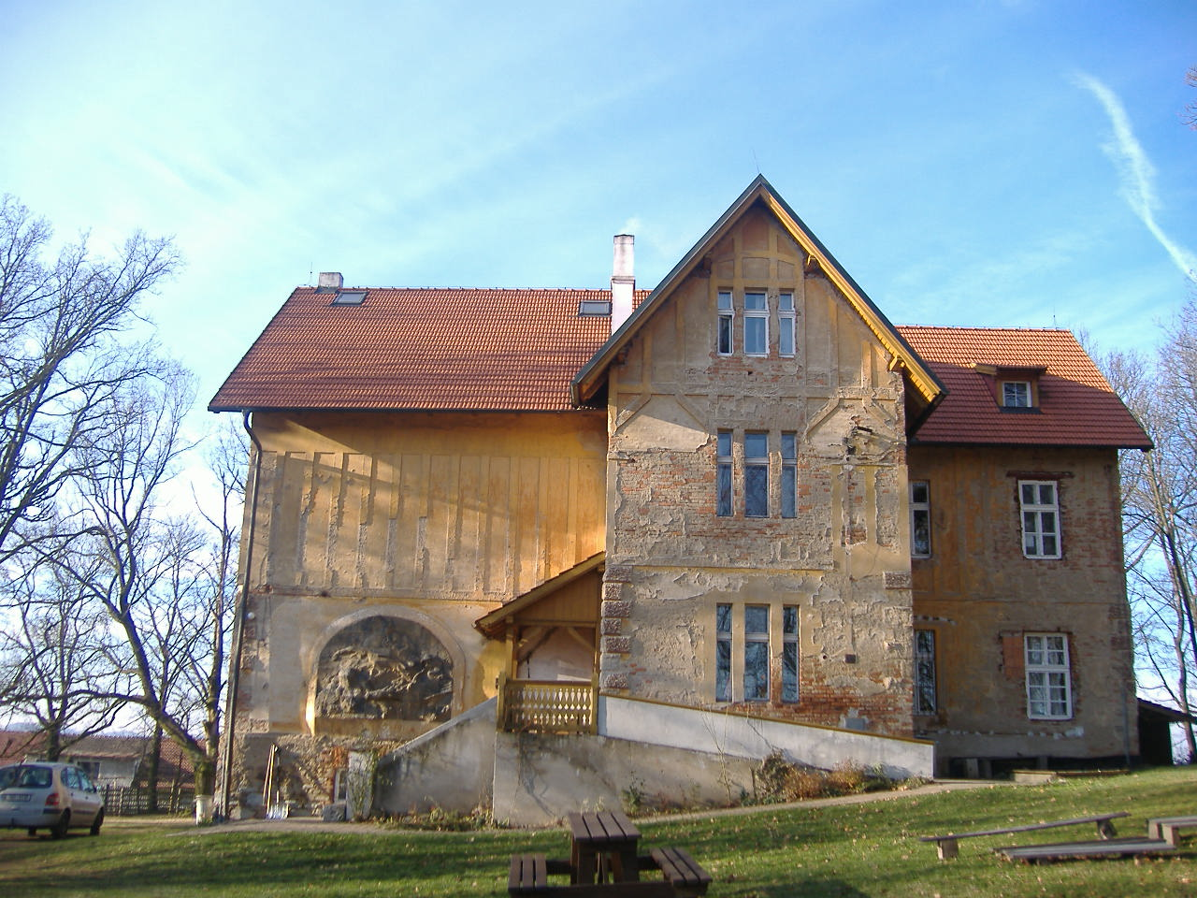
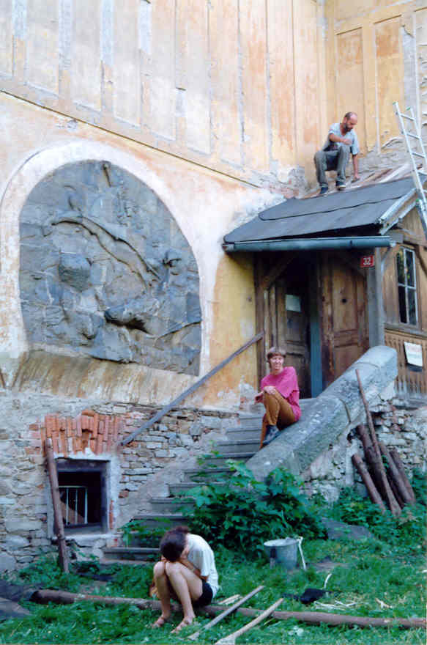
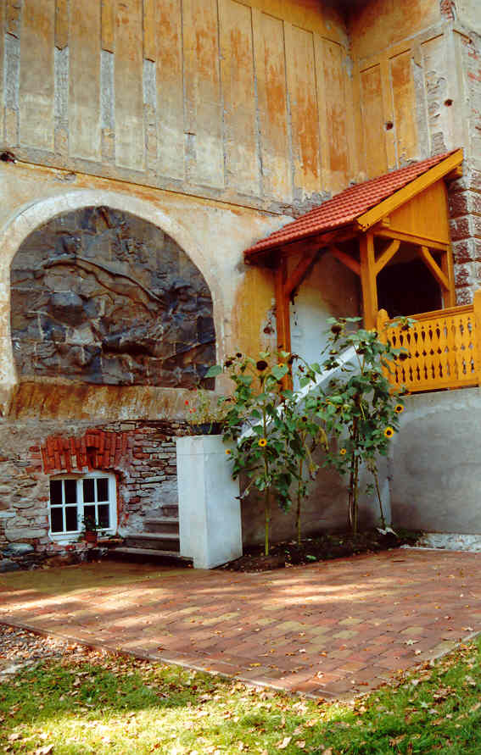

Slide 10
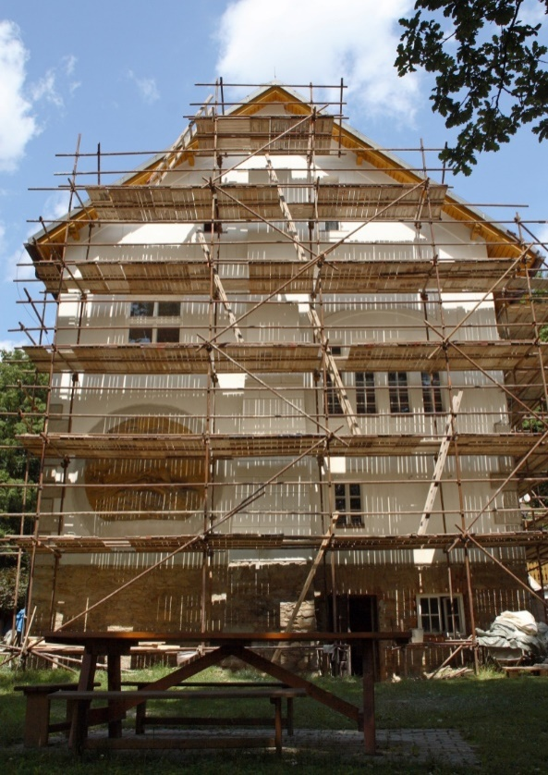
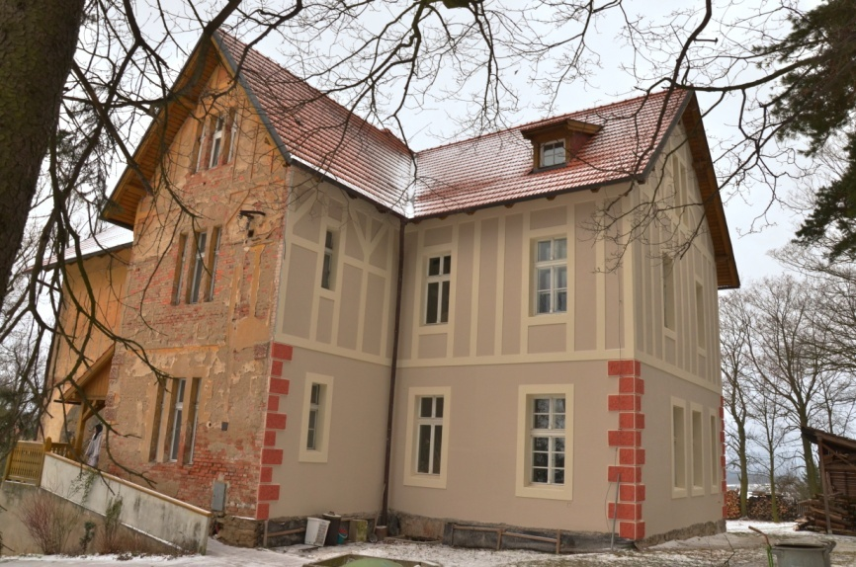
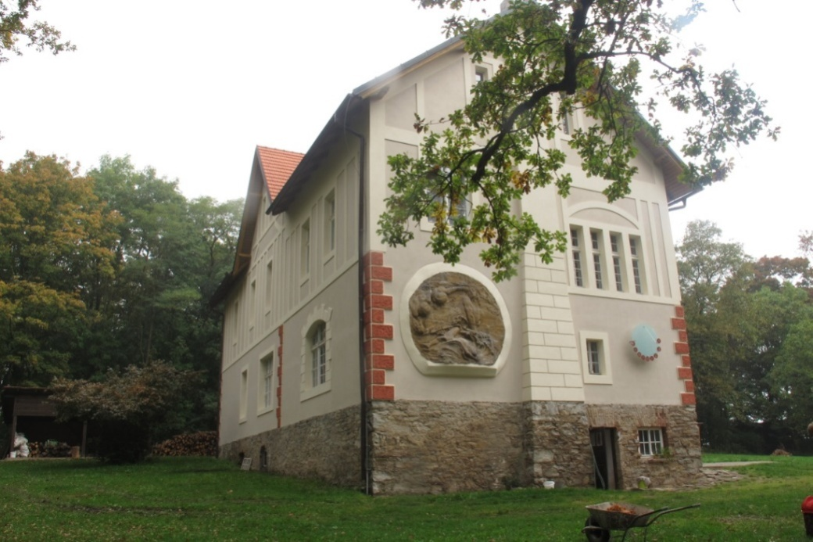

Slide 11
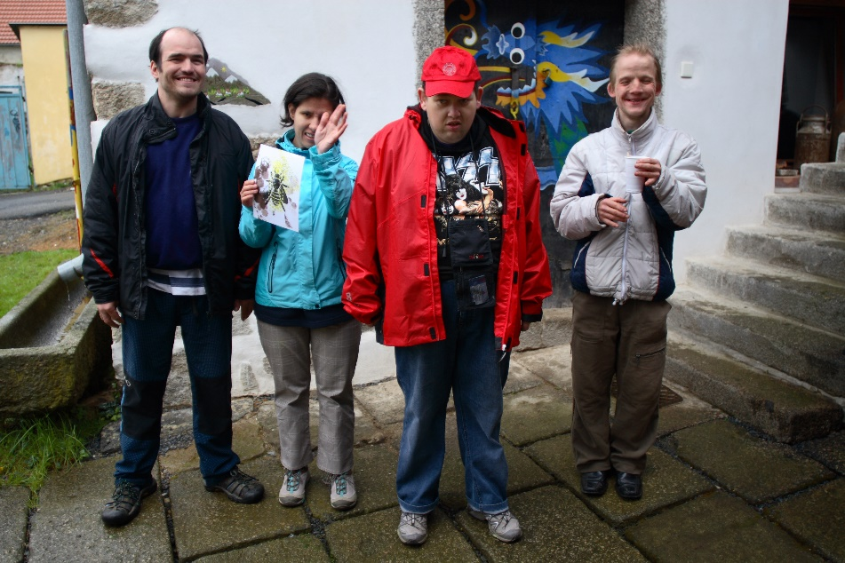
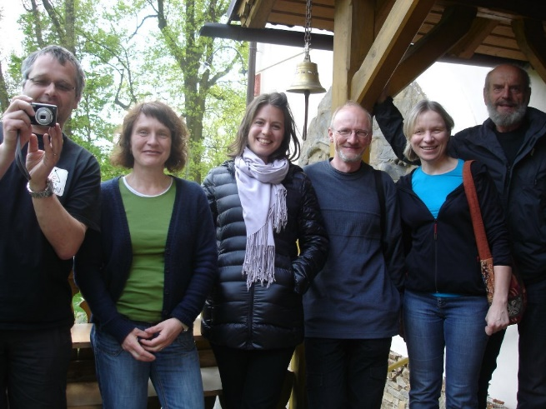
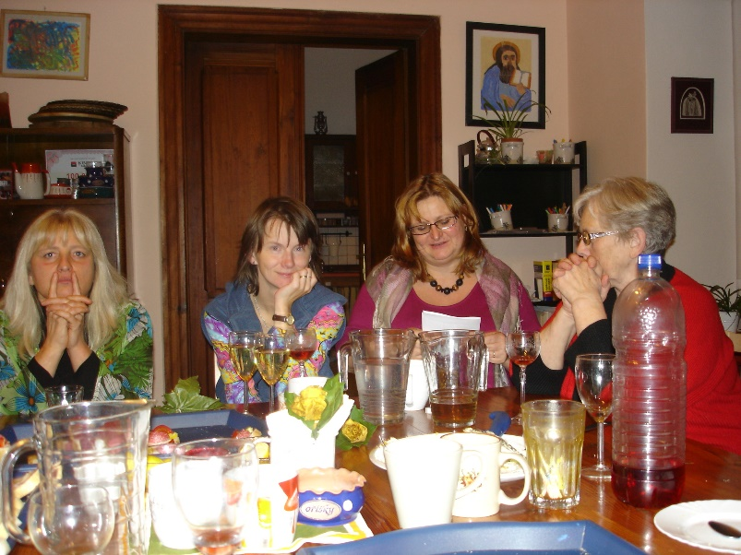
People in Villa Vallila
Core members
basic members of community
Community leader
Board members
Employees:
house leader
assistants
leader of workshop
technical workers
Volunteers

Slide 12
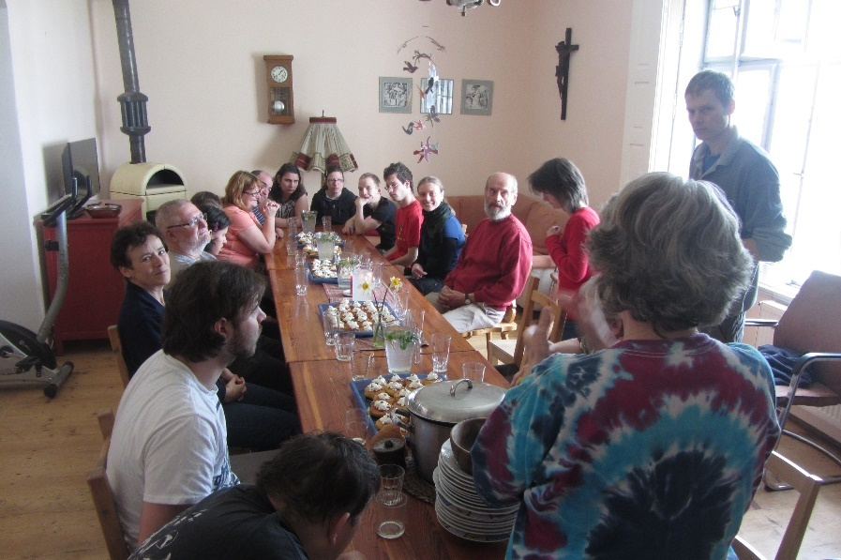
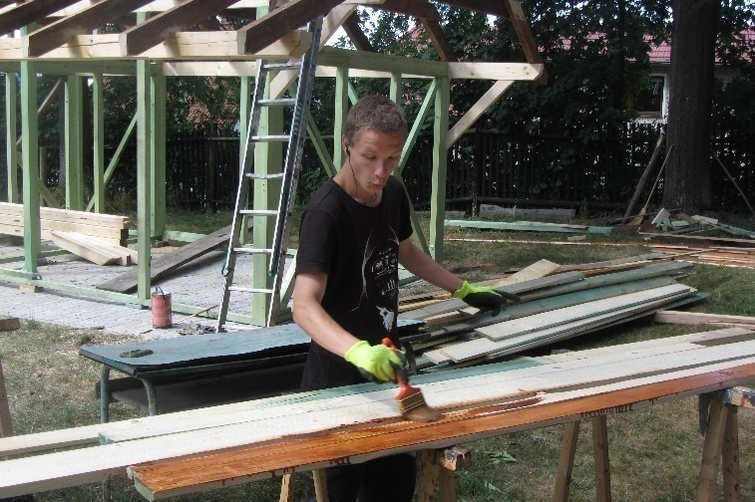
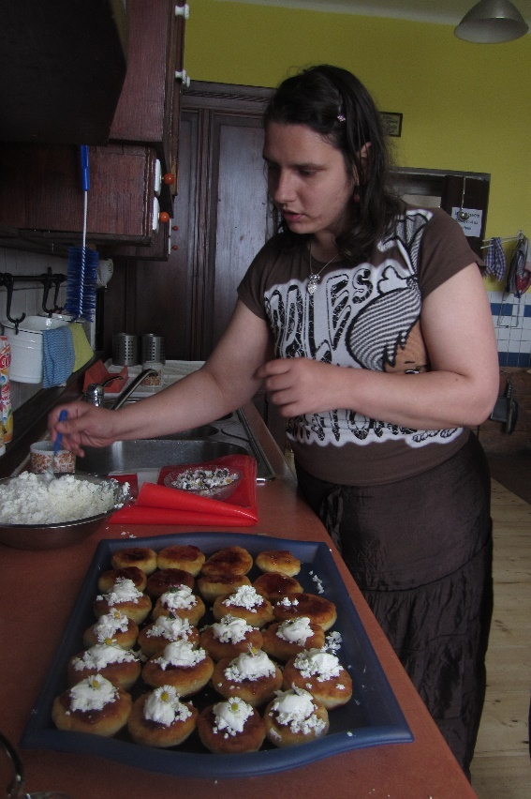
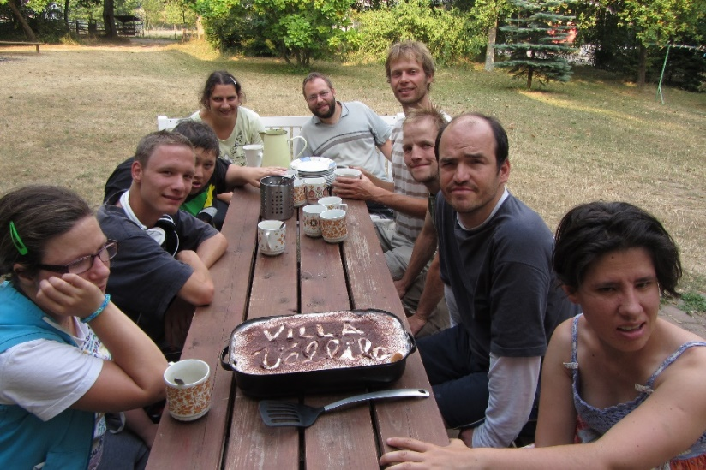
Community people

Slide 13
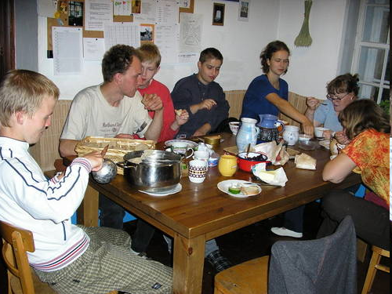
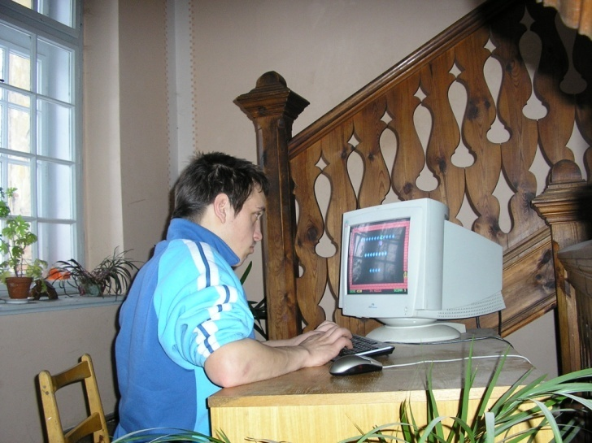
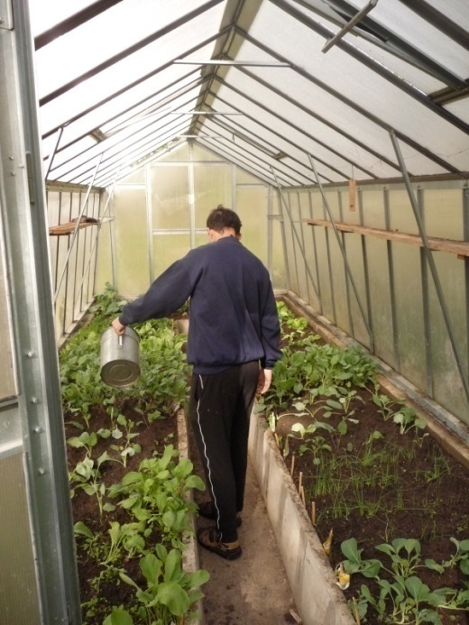
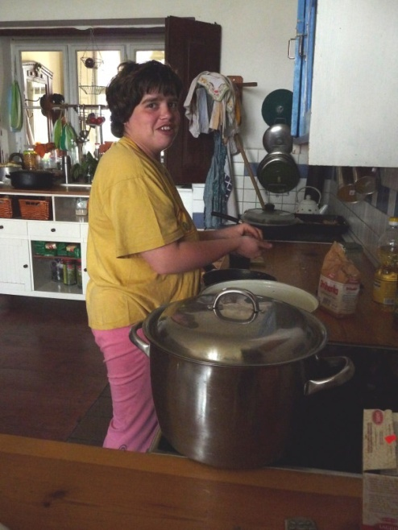
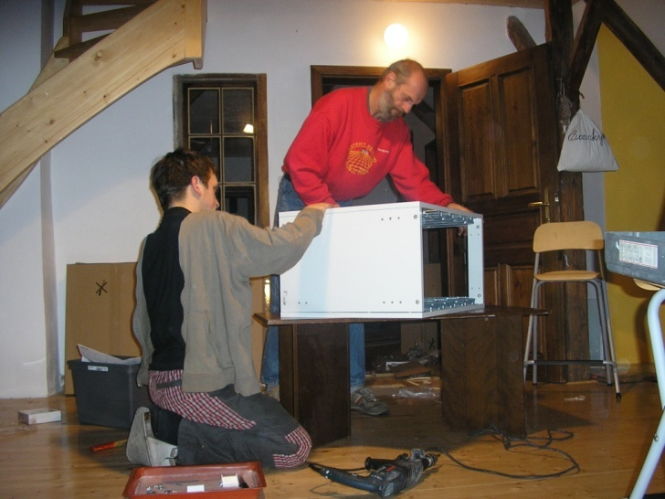
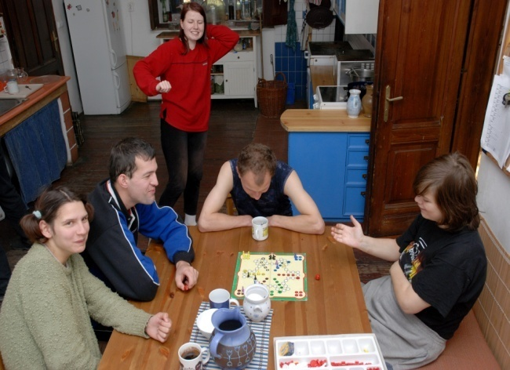
A Day in Villa Vallila…

Slide 14
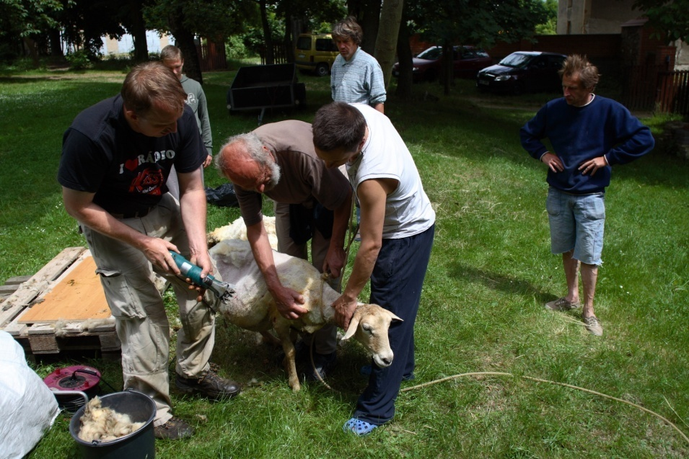
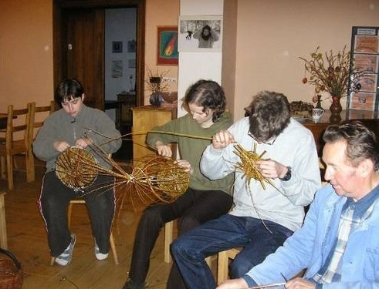
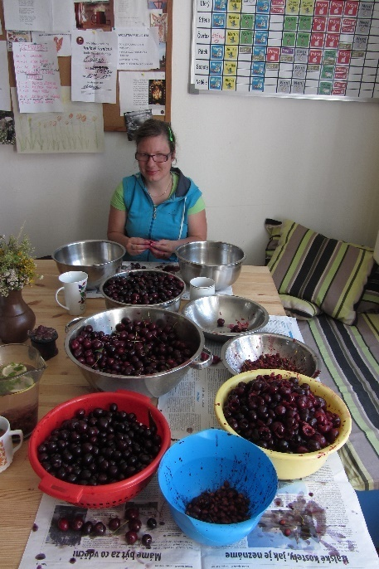
Our activities
Work on the farm,
in the workshop,
working with wood
Growing of fruit and vegetables
Community work
Common trips
in the mountains
or to the seaside

Slide 15
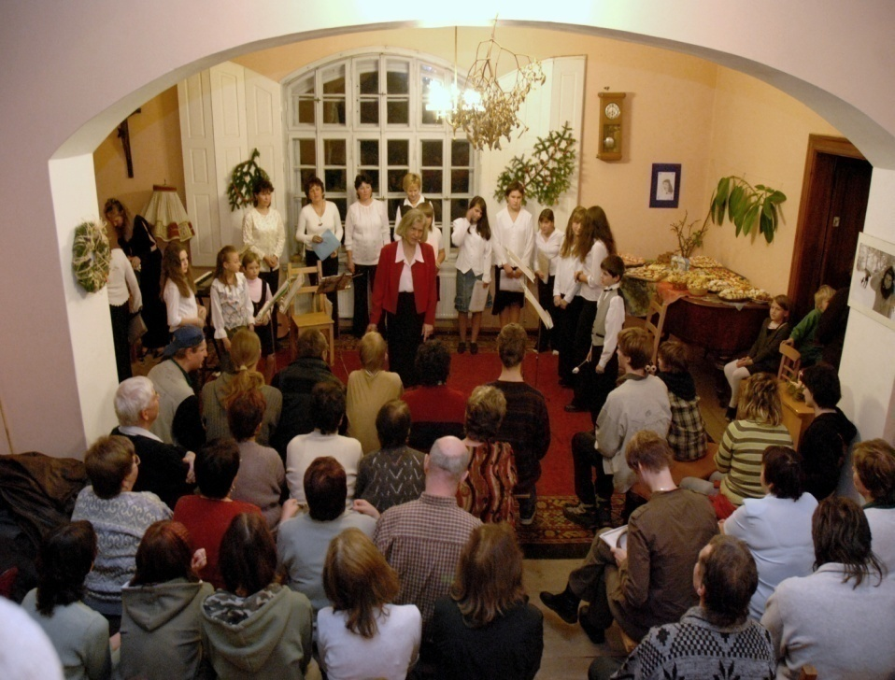
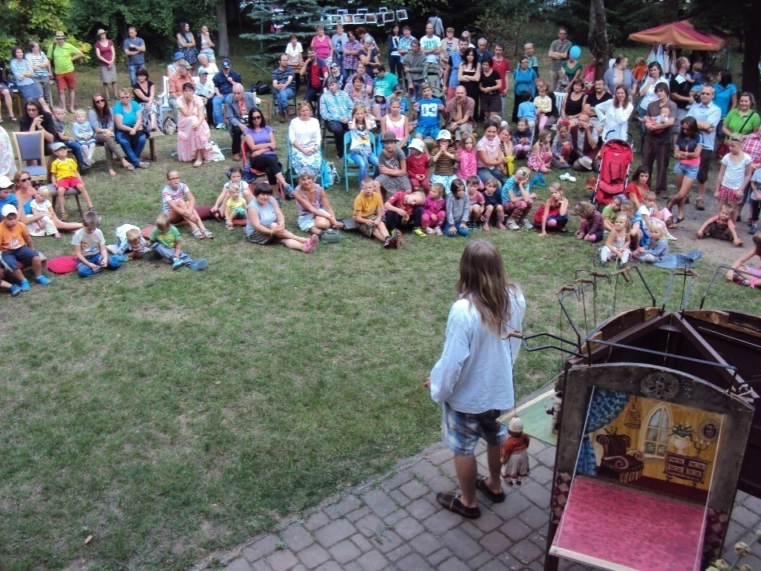
What we do more
events for the public - garden festivities, old craft demonstrations, advent concerts, discussions
presentation of the association - sales exhibition of the products of the socio-therapeutic workshop
organizing brigades with the participation of volunteers

Slide 16
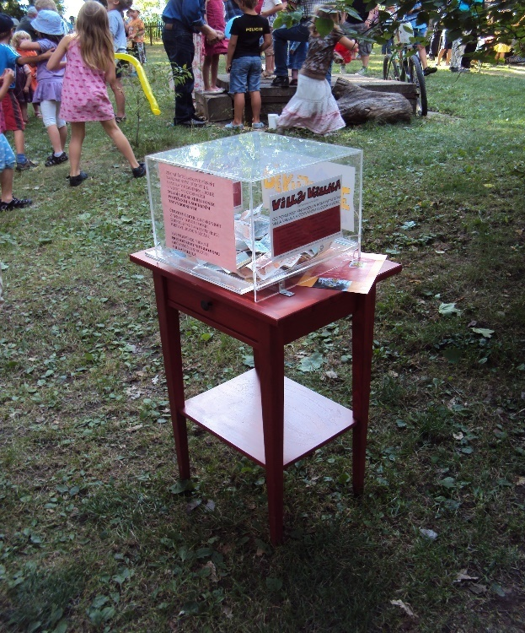
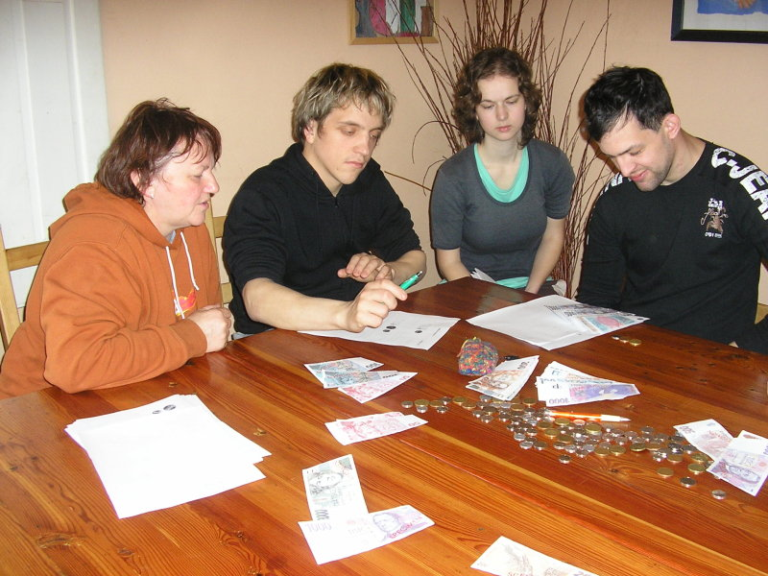
Financing
state budget - subsidies to regions – Central Bohemia Region, Prague the Capitol; Employment offices
foundations and endowment funds
sponsorship donations - businesses and individuals
payments from core members

Slide 17
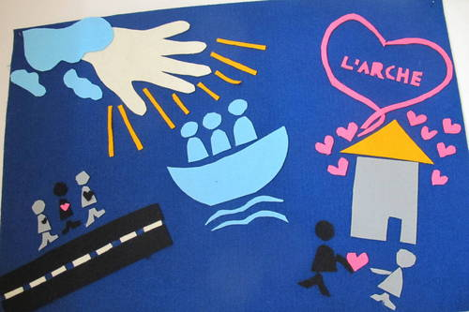
Our vision
To create community for people with disability and without and to share our life
To join to L´Archa international movement
To preserve a cultural monument
To ensure long-term funding

Slide 18
Inspiration by L´Archa of J. Vanier
The work of Villa Vallilla has been inspired from the very beginning by the ideas of Jean Vanier, who founded the Archa in 1964.
The community house Villa Vallila gradually created a community of inhabitants and assistants who try to live on the principles of Jean Vanier’s Archa.
The community of people with disabilities and their assistants is essential to all involved and helps discover the vital values of life and the uniqueness of each person's life.
Every person can only develop fully in the living community of other people.
Since 2011, we have been meeting regularly with the Archa coordinator who is accompanying us and our community is supporting us.
In recent years, meetings have been organized for assistants.
As part of the exchange of experience, we have visited several Archa communities in Europe - France, Ireland, Poland, Slovenia.
Meeting and spiritual inspiration is a great support for Villa Vallila's life.

Slide 19
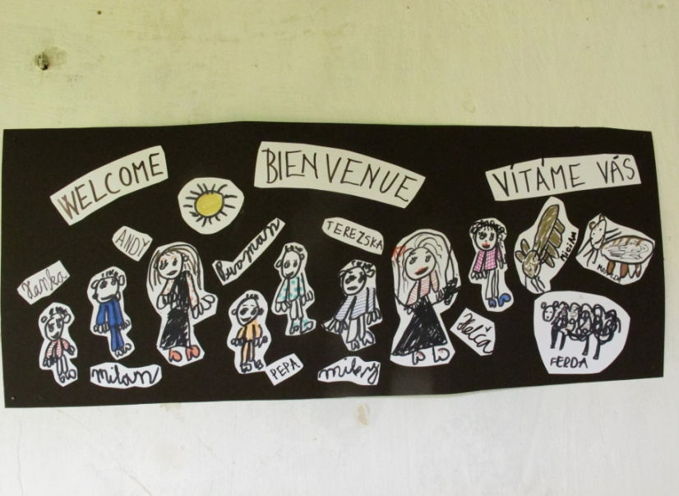
Contacts
Villa Vallila, z.ú.
Přemyslovská 23, 130 00 Praha 3
Cty leader: Eva Klípová
eva.klipova@seznam.cz
Community house Villa Vallila
House leader: Renata Kocourková
Červený Újezd u Votic 32, 257 88
tel: 317 802 106
e-mail: villa@vallila.cz
President of Board
Vít Herynek
herynci@volny.cz
www.vallila.cz

