Slide 1

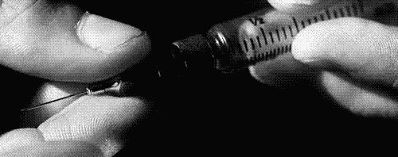
Addictions

Slide 2
Dictionary
Meth – pervitin
Poppy – mák
Average – průměrný
Applicant – žadatel
Treatment – léčba
Seize – zabavit
Field service – terénní služba
Harm reduction – snížení škod
Drop-in centre – kontaktní centrum
Detoxification unit – detoxifikační jednotka
Mental hospital – psychiatrická léčebna
Lung cancer – rakovina plic
Attention deficit disorder – poruchy pozornosti
Mood swings – nálady
Dose – dávka
Overdose - předávkovat
Anxiety – úzkost
Provides – poskytuje
Counseling - poradenství
Mediation - zprostředkování

Slide 3
Statistics (CR - 2011)
40 200 of problematic users
meth – 30 900, opiates – 9 300
Prague: 10 900
average age of applicant treatment – 27,4 years
Seized 441 kg of cannabis, 63 000 plants of cannabis
338 meth kitchens
29.4.2013,www.drogy.net,http://www.drogy.net/zpravy-a-statistiky/

Slide 4
Types of drugs
Get high (cocaine, extasy, speed, meth, tabacco…)
Calm down (alcohol, cannabis, gases, glues …)
Trip out (cannabis ketamine, LSD, magic mushrooms)
Get knocked out (heroin)

Slide 5
Help and support for people with addiction
Field service (harm reduction)
Drop-in center (harm reduction)
Detoxification unit
Mental hospital
Therapeutic community
Ambulant aftercare

Slide 6
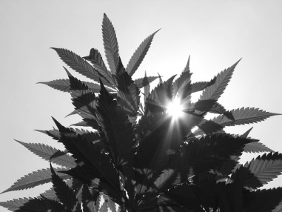
Cannabis
Grass, weed
Calm down, trip out
Smoking, baked in cake
Somebody can be anxious and paranoid
Can cause mental problems, lung cancer, problems with heart, attention deficit disorder
Skunk – can be 2-3 times stronger

Slide 7
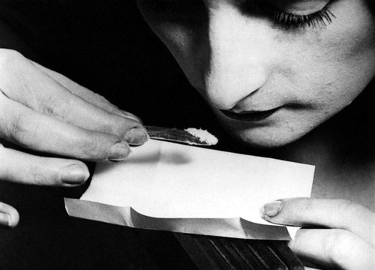
Cocain
Crack, Snow
Get high
Smoking (glass tube), or injected
Feel wide awake, can give you ego
Can cause hallucinations, mood swings, masive paranoia
In high doses can raise temperature, trouble sleeping, overdose

Slide 8
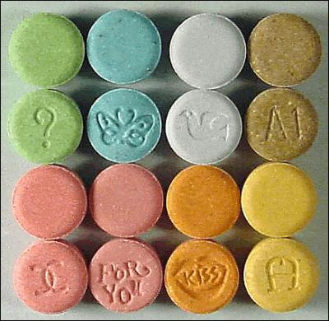
Extasy
Candy, Hug drog, happy pills
Get high
Usually colour pills with nice design
Loads of energy, feel more intense colours, sounds and emotions
Can cause anxiety, panic attacs and confusion
Raise temperature, cause dehydration

Slide 9

Sananim – Drop-in centre
Provides change of harm reduction material, hygienic service, social counseling, medical treatment, testing for syphilis, AIDS and hepatitis, mediated of treatment, counseling for family and close peoples

Slide 10
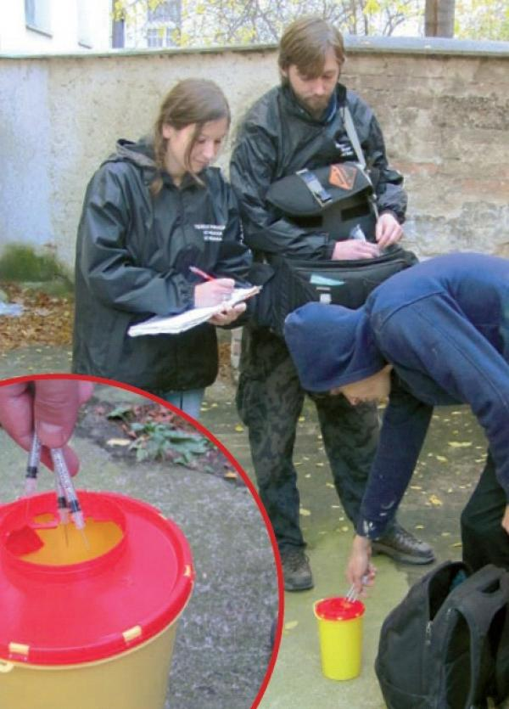
Sananim - Field service
reduce the risks
associated with
drug use directly
on the drug
scene

Slide 11
Quiz
1) Cannabis
2)Meth
3) Extasy
4)Cocain
5) Heroin
6)LSD
7) Alcohol
8)Medicaments
A) I am made of poppy.
B) I am vegetable origin, but I am not cannabis.
C) I want to dance with you.
D) They call me „trip“.
E) You can not be physical addict on me.
F) I am in beer.
G) They call me „ice“.
H)I can be prescribed by doctor.

Slide 12
Quiz
1) Cannabis
2)Meth
3) Extasy
4)Cocain
5) Heroin
6) LSD
7) Alcohol
8) Medicaments
1 E, 2 G, 3 C, 4 B,
5 A, 6 D, 7 F, 8 H
A) I am made of poppy.
B) I am vegetable origin, but I am not cannabis.
C) I want to dance with you.
D) They call me „trip“.
E) You can not be physical addict on me.
F) I am in beer.
G) They call me „ice“.
H) I can be prescribed by doctor.

Slide 13
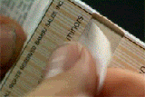
Thank you for your attention and I wish you good rest of the day.

