Slide 1
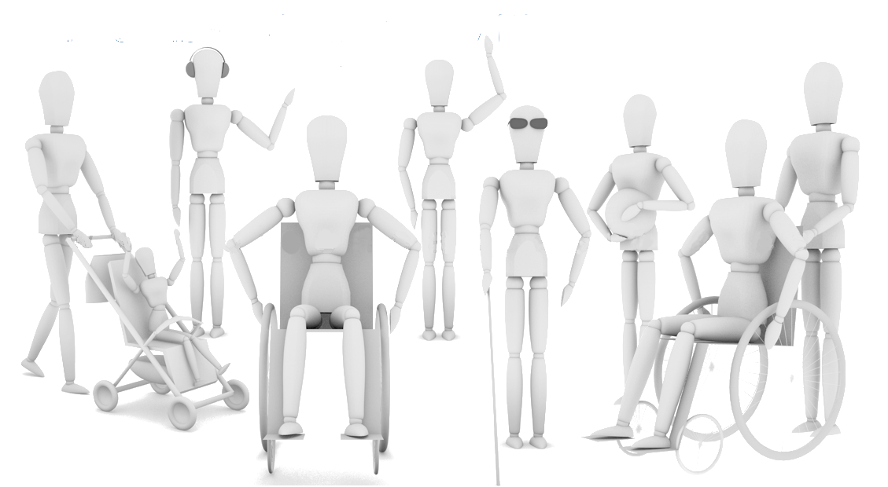
Disabilities

Slide 2

Contents:
what is a disability?
kinds of disabilities
factors cause disability
behavior of persons with disabilities
education people with disabilities
services
assistive technology

Slide 3
What is a disability?
disability limits a person:
    self-care
    mobility
    communication
    learning
    social life
    relationships with others people
    Dictionary:
    relations- vztahy

Slide 4
Kinds of disability
1. Physical disability
– Mobility impairment – e.g. paralysis,……
– Visual impairment – e.g. blindness, ……
– Hearing impairment
2. Mental disability – e.g. depression, …….
3. Learning (in the USA developmental) disability – e.g. mental impairment…….

Slide 5
Put the examples of the disabilities into the right columns:
Polio
Multiple sclerosis
Bipolar disorder
Arthritis
Low vision
Amputation
Schizophrenia
Down´s syndrome
Attetion deficit disorder and attention deficit
hyperactivtiy disorder
Colour blindness
Cataract
Muscular dystrophy
Autism
Dictionary:
Blindness – slepota
Cataract – šedý zákal
Polio – obrna
Disorder- porucha

Slide 6
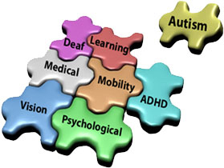
Correct answers
Mobility impairment | Visual Impairment | Hearing impairment | Mental disability | Learning disability
polio multiple sclerosis arthritis amputation muscular dystrophy | low vision colour blindness cataract |  | bipolar disorder Schizophrenia | Down´s syndrome Attetion deficit disorder and attention deficit hyperactivtiy disorder autism

Slide 7
Factors cause disability
What factors cause disability?
infection before birth
infection during birth
growth problems
problems with genes
poor diet
poor health care
drug use during pregnancy
smoking and drinking alcohol during pregnancy
Dictionary:
growth – růst

Slide 8
Behavior of persons with disabilities
self - injurious behaviour
      such as: hitting, biting
aggressive behaviour
      such as: hitting others, screaming, spitting, kicking
inappropriate sexualised behaviour
behaviour directed at property
      such as: stealing
stereotyped behaviour
      such as: repetitive rocking

Slide 9

Education
compulsory education
special classes
special aids
lower number of pupils
individual education plan

Slide 10
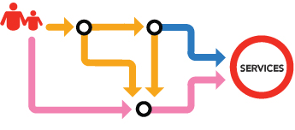
Services
At home:
  one – to - one assistant
  support worker
  day centre
Residential accommodation:
  staffed around the clock

Slide 11
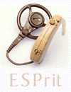
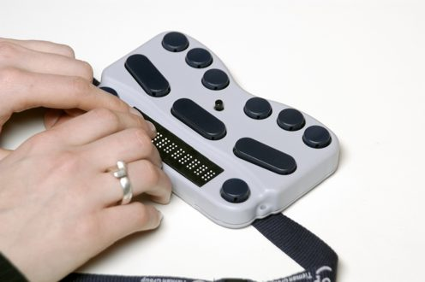
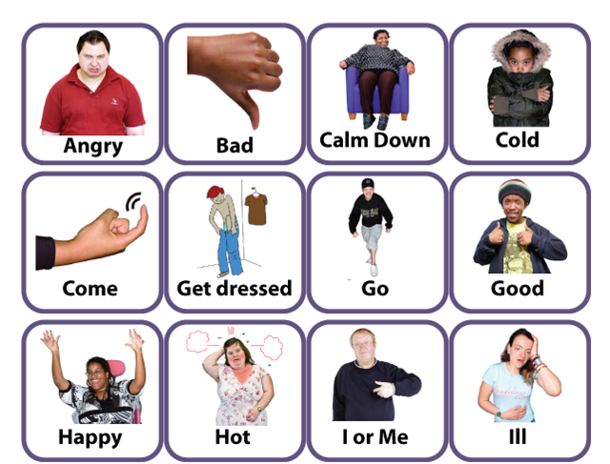
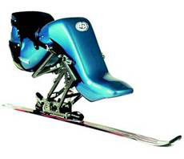
Assistive technology
Assign an assistive technology in the picture by type of disability.
                A)
                B)
            C)
D)
physical disability
mental disability
visual impairment
hearing disability

Slide 12

Crossword
How many people live in the CR with hearing disabilities.
Depression is a disability …
Pupil with disability used …
těhotenství
What is the typical behavioral of person with disability
What include of learning disabilities?
křičet
At home services include: one-to-one assistant, support worker and …
The special seat attached to a single ski is called …
self-injurious behavioral is hitting and …

Slide 13

Thank you for your attention.

