Slide 1
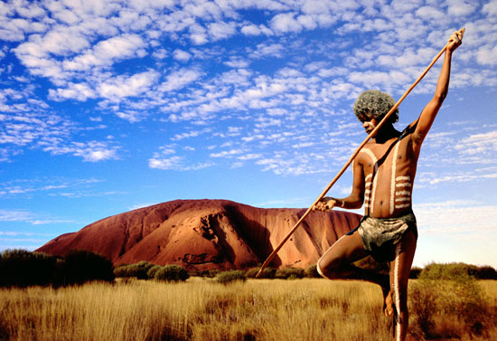

Slide 2
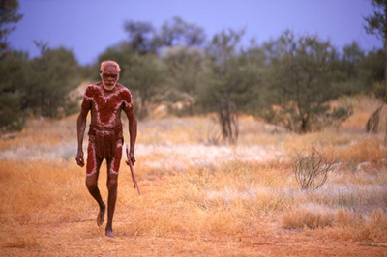
http://www.youtube.com/watch?v=Gf0RrQ62jw8&feature=related

Slide 3
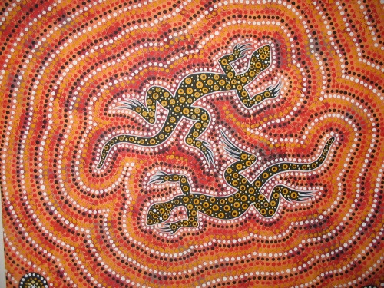

Slide 4
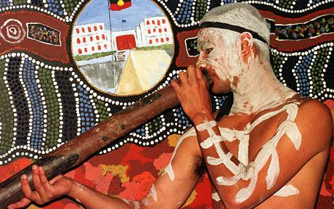

Slide 5
The Rainbow Spirit Elders

Slide 6
The Rainbow Spirit Elders
The Rainbow Spirit Elders
The Rainbow Spirit Theology
The Rainbow Spirit
The Sources Of Rainbow Spirit Theology
The Land
Jesus Christ As An Australian Aborigine
Conlusion

Slide 7
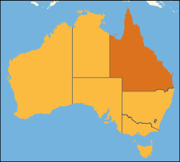
The Rainbow Spirit Elders
Rainbow Spirit Elders
History of Aborigines (latin ab origine „from the beginning“)
Their living

Slide 8
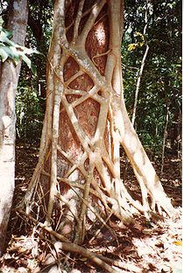
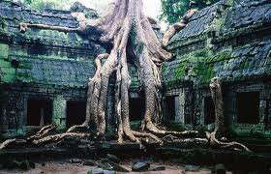
The Rainbow Spirit Elders
The key word is the strangler fig.

Slide 9
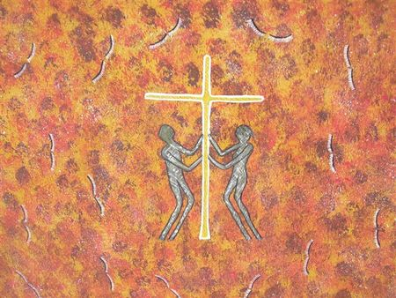
The Rainbow Spirit Theology
The Elders of The Rainbow Spirit are both Christian and Aboriginal
Their theology is based on history and experience

Slide 10
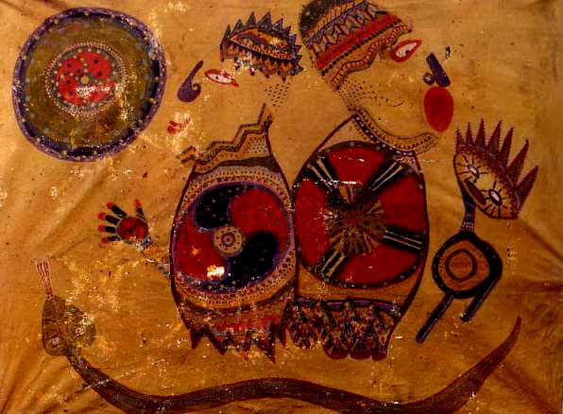
The Rainbow Spirit
Who is the Rainbow Spirit?
Symbol – life and rebirth
The „Dreaming“

Slide 11
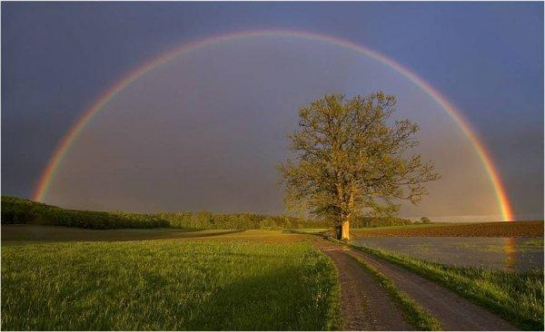
The Rainbow Spirit
„The Rainbow Spirit is the symbol of the new day which dawns (úsvit) after the rain sent by the Rainbow Spirit. The rainbow that appears in the sky, is the peace after the storm, the promise of God to care for all creation.“ (Genesis 9)

Slide 12
The Sources Of Rainbow Spirit Theology

Slide 13
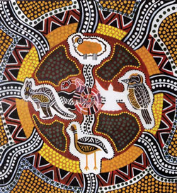
The Sources Of Rainbow Spirit Theology
The model their theology:

Slide 14
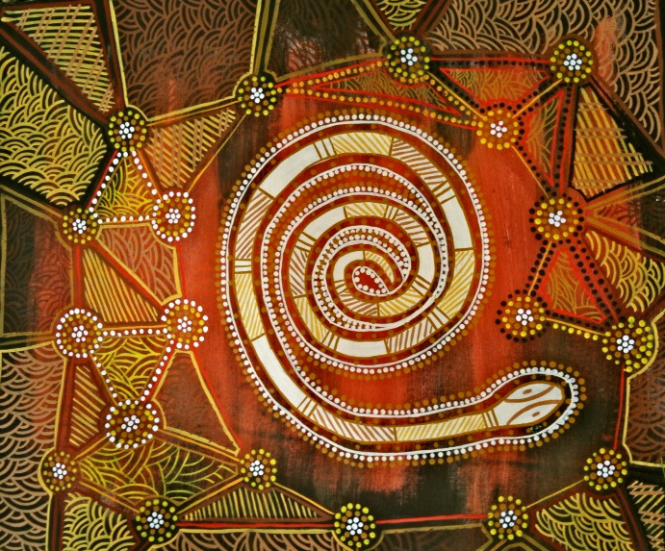
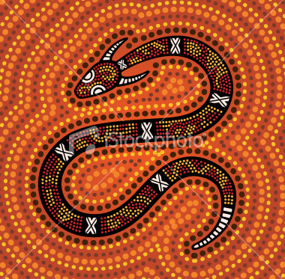
The Sources Of Rainbow Spirit Theology

Slide 15
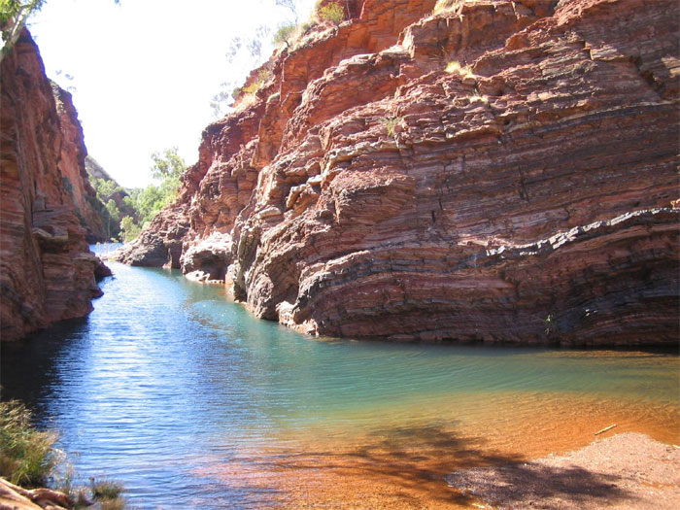
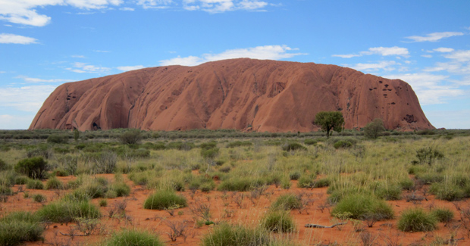
The Land
Strong relation between Aborigines and the land
The Creator Spirit is a landowner (majitel půdy), while humans are only regent (správce) of the land
Western urbanites have so pillaged (loupit, plenit) the land, the ecosystem
They clowned aborigines

Slide 16
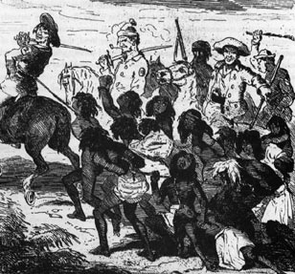
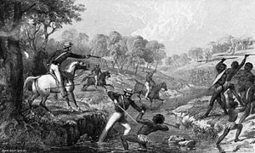
The Land
Deep spiritual crisis ☹ -> seizing (obsazování) of the land by immigrants

Slide 18
The Land
Poisoning of streams and waterholes
The intent (úmysl) of exterminating Aboriginal families
Humiliation (ponižování) of Aborigines through public punishments
Sexual violation of Aboriginal women
Desecration (zneuctění) of Ab. sacred places

Slide 19
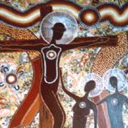
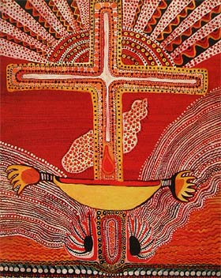
Jesus Christ As An Australian Aborigine
For the Aborigine people exist only Aboriginal Jesus
A key phrase here is „Christ is revealed“

Slide 20
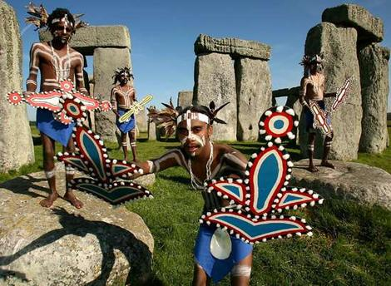
Conclusion
Aborigines are a tribe who:
Love dance
Love a land, soil, trees, animals, nature
Love sing
Love art
Communicate face-to-face
Many countries should learn from them, for example ecology, venerated (úcta) to ancestors(předci) or love to land and all life ever.

Slide 21
http://www.youtube.com/watch?v=DnZNEbo-Zzo&feature=related

