Slide 1

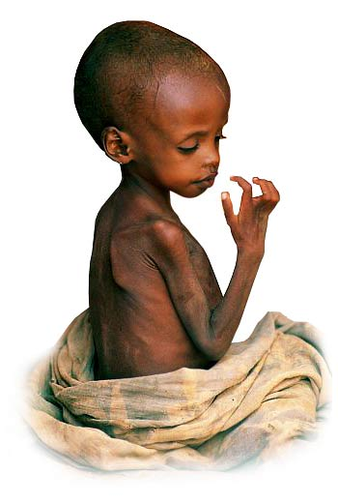
Unit 17
Humanitarian aid, NGOs, Charities

Slide 2
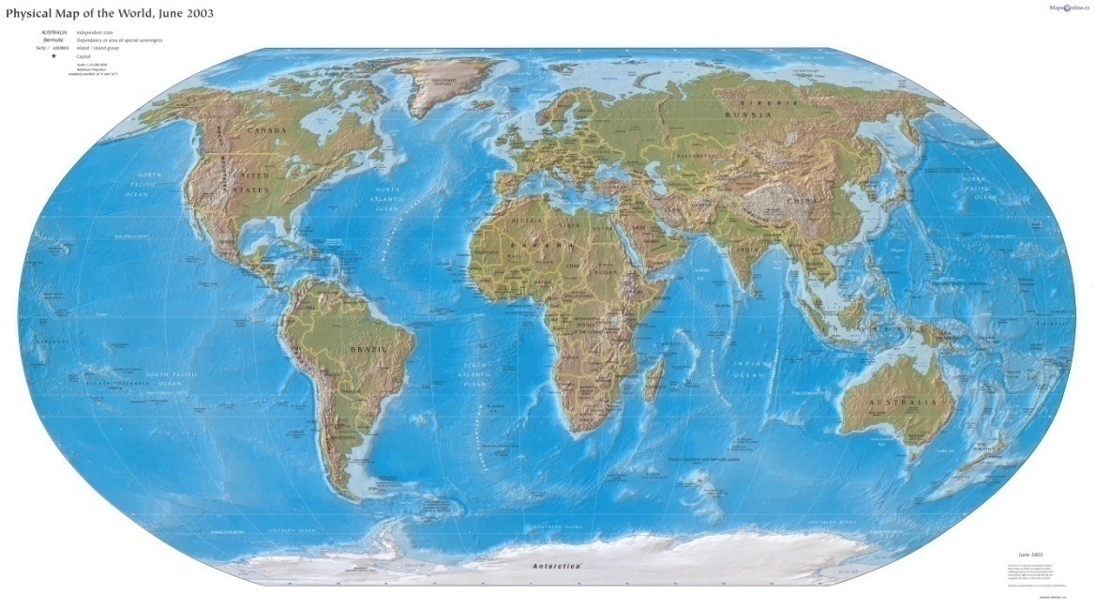
Content
Important terms
Organization
Unicef

Slide 3
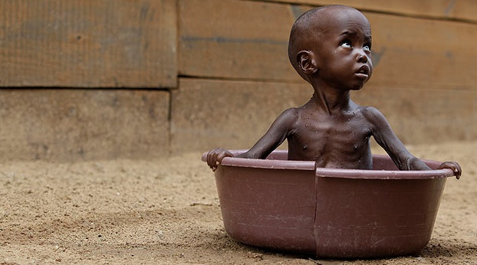
Humanitarien crisis
What is humanitarien crisis?
  Event, which represents a critical threat
Crisis has a lot of species, …
  Natural disasters, technological disasters, long-term man-made disasters and war
The crisis can cause, …
Event – událost
Theart – hrozba
Longt-term man-made – dlouhodobé působení člověka
Cause -způsobit
Notes:
is an event which represents a critical threat to health, safety, security or well-being of community or other lage group of people, usually over a wide area

Slide 4
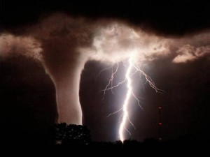
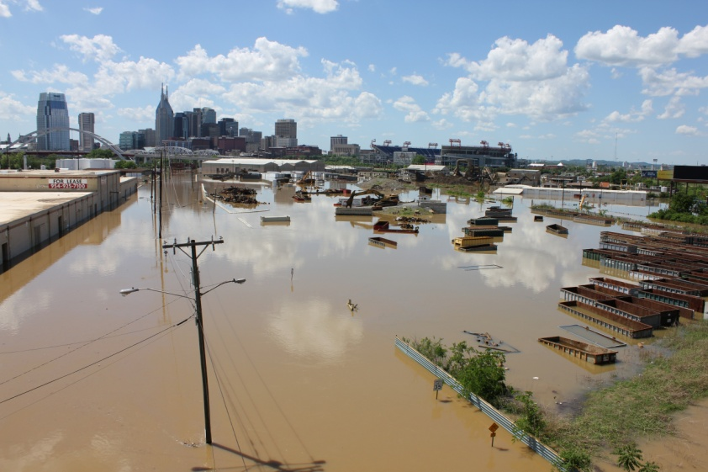
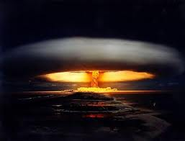
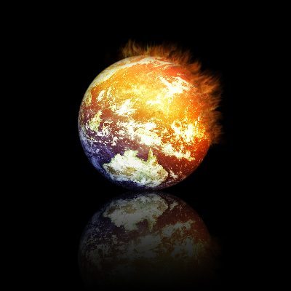
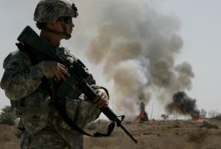

Slide 5

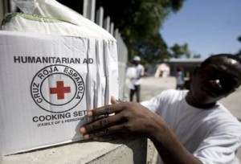
Humanitarian aid
What is humanitarian aid?
  Material or logistical assistance
Types of aid:
Same organizations: Red Cross and Red Crescent Societies
Crescent -půlměsíc
Notes:
Is material or logistrical assistance provided for humanitarian purposes, typically in response to humanitarien crises

Slide 6

Humanitarian principles
What is humenitarian principles in organizations?
  help to protect life and alleviating suffering
Humanity – respect for the individual
Impartiality- to help all people without distinction
Independence – independently of hostilities actions
Neutrality -for themselves
Proselytism - protect victims from abuse of political or religiouns creeds
Alleviating suffering- umírnění utrpení
Impartiality- nestrannost , Distinction – rozdíl
Proselytism – získávání druhých pro své účely
Victim –obět , Abuse- zneužítí
Creeds- vyznání

Slide 7
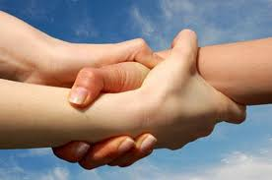

Types of organizations
Charitable org.
Non-govermental org.
Non-profit org.
Charitativní organizace
Nevládní organizace
Nezisková organizace

Slide 8
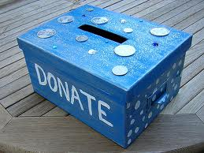
Charitable organizacion
Charity represents the state in its duties of
It must be registered under state and report about its financial
Charities generally enjoy tax exemption for thier income, and donors generally enjoy tax reliefs for gift to charity
Duties - povinostech ,Tax exemption – osvobozeni od daně, tax reliefs – daňová úleva

Slide 9

Non-governmental organization
It is not directly part of the structure of government
Exist for a variety of purposes, usually to further the political or social goal of their members
Used to improve the situation such as human rights and natural environment
Variety for purposes –různé účely, goal- cíl, improve- zlepšení

Slide 10
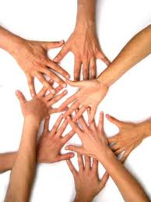
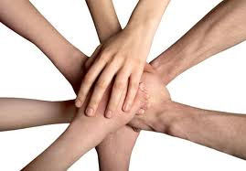
Non-profit organization
  Primary objective is to support an issue or matter of private interest or public concern for non- commercial purposes
  Relate to areas such as art, education …
Support – podpořit, concern- zájem, purposes –účel, relate – týkající se

Slide 11

UNICEF
  What is Unicef ?
    It is organization, whose …
    Protect childern from violence and abuse and from exploitation through child labour or trafficking
    Protect childern in the midst of war and natural disaster
Violence –násilí, abuse- zneužívání, exploitation through child labour- vykořisťování přes dětskou práci, trafficking – obchodování s

Slide 12
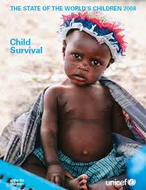
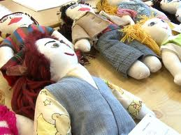
Unicef work in 150 countries around the world
They work with local government …
They belives that every child should have …
  Clean water, food, heath, care, education, safe
Do you want to help?
You can make the dolly or adopt the dolly. :-D
www.unicef.cz

Slide 13
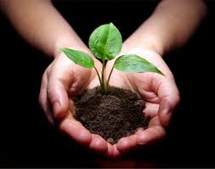
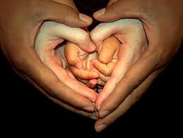
Thank you for your attention

