Slide 1
EDUCATION
UNIT 11
TOMÁŠ KAŠPAR
VERONIKA KAPALÍNOVÁ
ALL RIGHTS RESERVED
2012

Slide 2
WHAT IS IT
EDUCATION ?
2 from 25
Followed by: content

Slide 3
CONTENT
Education in the United States
What is it … ?
Education in Great Britain
Photos
Education in the Czech Republic
3 from 25
Followed by: E. in USA and question for you

Slide 4
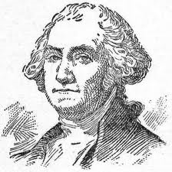
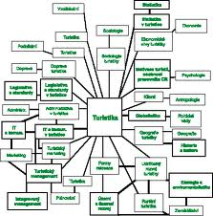
EDUCATION
in the United States
Education in general
Preschool education
Elementary and secondary school
Junior and senior high school
College and University
4 from 25
Followed by: question for you

Slide 5
DO YOU THINK
EDUCATION
IS IMPORTANT?
5 from 25
Followed by: USA - E. in general

Slide 6
EDUCATION
in the United States
Education in general
Provided, controled and funded by government
- from three levels:
FEDERAL
STATE
LOCAL
Educational standards are usually
made by state governments !!!
Teaching are set through locally elected
SCHOOL BOARDS !!!
6 from 25
Followed by: USA - Preschool E.

Slide 7
EDUCATION
in the United States
Preschool education
NO mandatory public preschool
NO mandatory public for créche school
THIS SITUATION IS FOR ALL UNITED STATES !!!
HELP FOR:
children of low-income families
families without mother or father
special care for disabled children
7 from 25
Followed by: USA - Secondary E.

Slide 8
EDUCATION
in the United States
Elementary and secondary school
Schooling is compulsory for all people
Most people begin elementary education
AGE: TO ELEMENTARY: 6-7 YEARS OLD
TO SECONDARY SCHOOL: 12-13 YEARS OLD
Types of school: public or private institution
85 % students at public schools
15 % students at private schools
SIX lessons per day
HOLIDAYS: about two and half months
JUNE - AUGUST
8 from 25
Followed by: USA - High E.

Slide 9
EDUCATION
in the United States
Junior and senior high school
7-8 degrees (MOSTLY)
First is Junior school
AFTER senior high school
VERY HIGH SCHOOL LEVEL
GRADUATION EXAMS IS CONDITION
wide variety of elective courses
- computers
- visual arts
- publishing etc.
They may take standardized tests
depeding on their local graduation exam !!!
9 from 25
Followed by: USA - University

Slide 10
EDUCATION
in the United States
College and University
AFTER high school
Four years of study
Students traditionally apply to receive
admission into college !!!
The most prestigious schools are private
NOT PUBLIC SCHOOLS !!!
END OF STUDING IS BACHELOR LIST
SCHOLARSHIPS – VERY POPULAR AND SURE
- they are widely avaiable
STUDENT LOAN
- very favourite
- risk for banks
10 from 25
Followed by: personal question

Slide 11
PERSONAL QUESTION:
ARE YOU HAPPY
WITH YOUR
EDUCATION ?
11 from 25
Followed by: What is it … ?

Slide 12
What is it …?
school boards
scholarship
public school
private school
cheerleader
graduation
12 from 25
Followed by: E. in Great Britain

Slide 13
EDUCATION
in Great Britain
Primary education
Secondary education
Higher education
Adult education
13 from 25
Followed by: GB – Primary E.

Slide 14
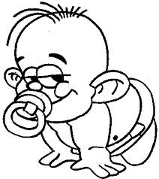
EDUCATION
in Great Britain
Primary education
For children between the ages 5-11
Sometimes togehter with nursery school
Primary school is:
infant school (5-7)
+
junior school (7-11)
FOR BETTER UNDERSTADING:
I´m 8 and I´m pretty ☺
I´m 5 and I like pacifier !
PRIMARY
SCHOOL
+
=
14 from 25
Followed by: GB – Secondary E.

Slide 15
EDUCATION
in Great Britain
Secondary education
(In England, Wales, Northern Ireland):
PRIMARY
SCHOOL
SECONDARY
SCHOOL
(usually transfer at the age 11)
Secondary education is not COMPULSORY
At the age 11 you can go to work !!!
At the age 13-14:
choose subjects for final
examinations
SECONDARY
SCHOOL
HIGHER
EDUCATION
15 from 25
Followed by: GB – Higher E.

Slide 16
EDUCATION
in Great Britain
Higher education
THREE GROUPS:
1) Oxford and Cambridge (Oxbridge)
2) Redbrick universities (London, Bristol etc.)
3) The new universities (after 1960)
The age for universities is about 18
FINISH IS:
academy degree
diploma
Higher education is paid !!!
STUDENT LOANS OR SCHOLARSHIP
= higher education is not for everybody !!!
16 from 25
Followed by: GB – Adult E.

Slide 17
EDUCATION
in Great Britain
Adult education
For everybody !!!
THE AGE IS NOT OBSTACLE
Different lifelong learning
Two general types:
ACCESS PROGRAMME
OPEN UNIVERSITY
ACCESS PROGRAMME:
1 or 2 year courses to allow
adults access to university
OPEN UNIVERSITY:
a distance learning programme
which can result in a degree
17 from 25
Followed by: Photos

Slide 18
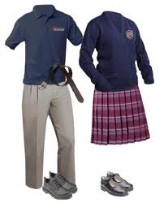
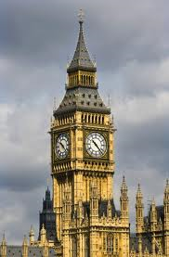
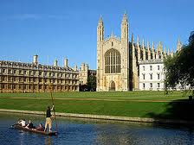
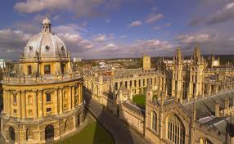
PHOTOS
DOPLOMA WITH UNIVERSITY CAP
SCHOOL
UNIFORMS
CAMBRIDGE
BIG BEN
OXFORD
18 from 25
Followed by: question for you

Slide 19
SCHOOL UNIFORMS
KO
KO
OK

Slide 20
WHAT DO YOU THINK
ABOUT
CZECH EDUCATION ?
20 from 25
Followed by: E. in Czech Republic

Slide 21
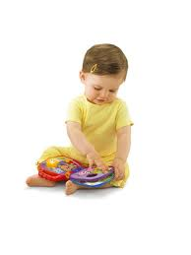
EDUCATION
in the Czech Republic
Pre-school education
+ Basic education
Secondary education
Tertiary education
+ Higher professional schools
+ University education
21 from 25
Followed by: CZ - Pre-school E.

Slide 22
EDUCATION
in the Czech Republic
Pre-school education
+ Basic education
Pre-school is for children 3-6
Group activities
Basic behavioral habits
Communication skills
Provide of special pedagogical care
Basic education lasts 9 years
Primary and lower secondary levels of education
Grammar school:
more information
university is sure next school
Motivation for lifelong learning
22 from 25
Followed by: CZ - Secondary E.

Slide 23
EDUCATION
in the Czech Republic
Secondary education
Types of secondary school:
1) Secondary general school
- grammar school too
2) Secondary technical school
3) Conservatory
- general
- vocational
School can be:
- public
Education at public school
- private
IS FREE !!!
- church
23 from 25
Followed by: CZ - Tertiary E.

Slide 24
EDUCATION
in the Czech Republic
Tertiary education
+ Higher professional schools
+ University education
Higher professional school:
practically oriented
prepare students
for 3 years
University education:
bachelor study programme (for 3 years)
after: master study programme (for 2 years)
after: doctoral programme (for 3 years)
Public universities are FREE while !!!
Private universities are with school-fee
24 from 25
Followed by: END ☺

Slide 25
THANK
YOU
ATTENTION
FOR
YOUR

