Slide 1
ADDICTIONS
Unit 1
Fiona Valerie Cuce, Hana Zahajská
2012

Slide 2
Content:
Kinds of addictions
Types of drugs
Organizations
Game for you

Slide 3
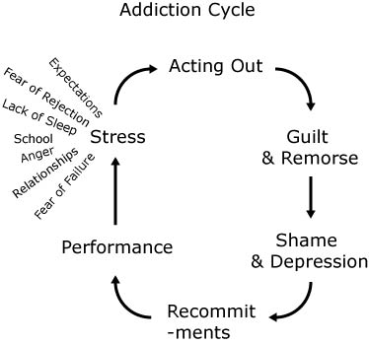
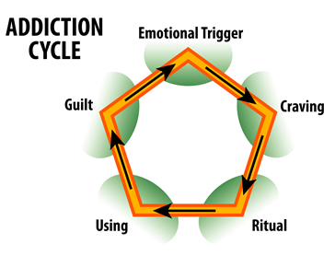
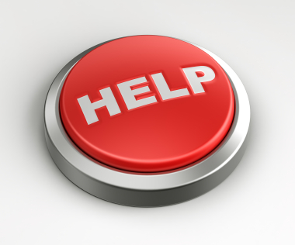
Kinds of addictions:
Main of them:
alcohol and tobacco caffeine
medicine, pills
gambling
drugs
Emotional trigger – citový spouštěč
Craving – touha, chuť, bažení, žádostivost
Guilt – vina, pocit viny

Slide 4
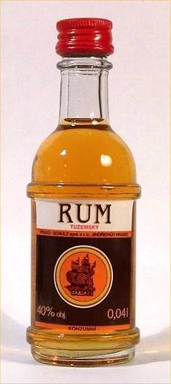
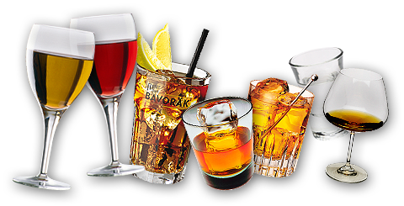
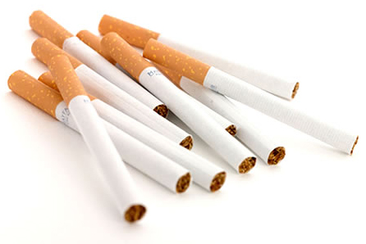
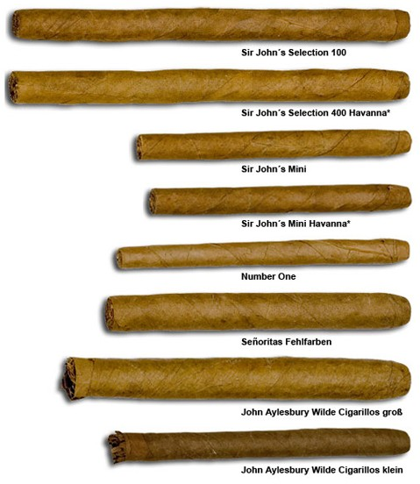
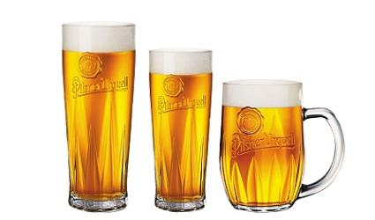
Kinds of addictions:
These addictions are well – know!
Alcohol Tobacco
These drugs are legal!

Slide 5
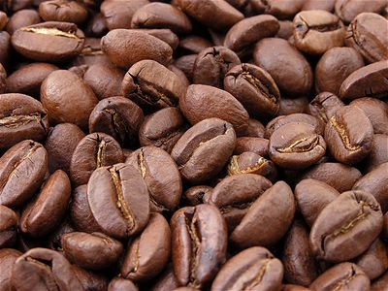
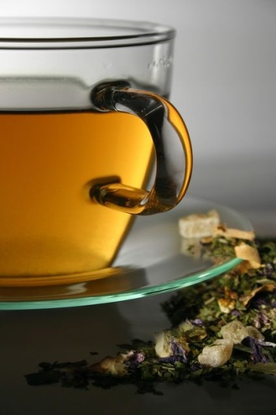
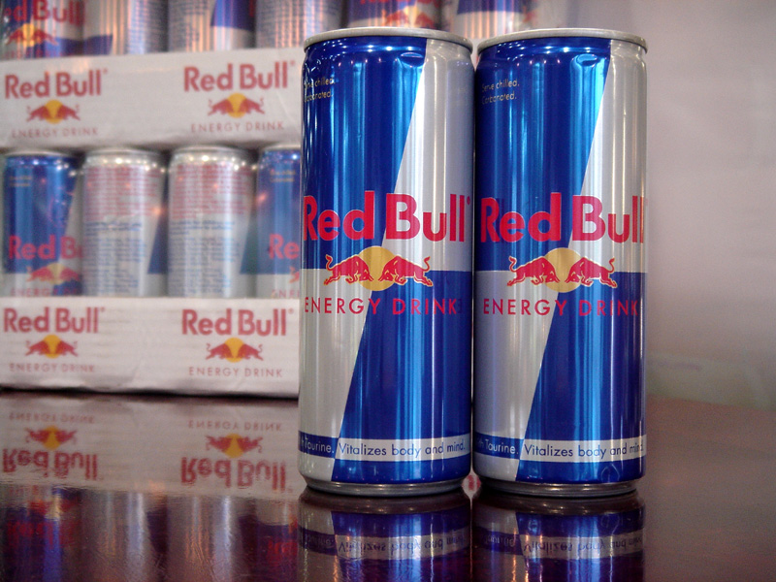
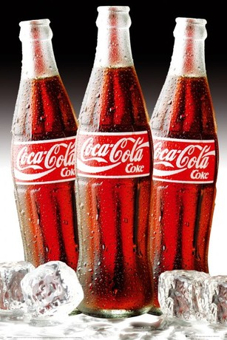
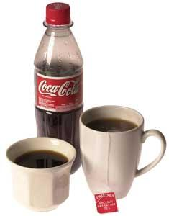
Caffeine:
- Stimulate your central nervous system
- Caffeine counteracts sleep
- Is legal
- In: tea, coffee, cacao, energy drinks, fizzy drinks such as coca cola
for interesting: in North America 90% of adults consume caffeine daily

Slide 6
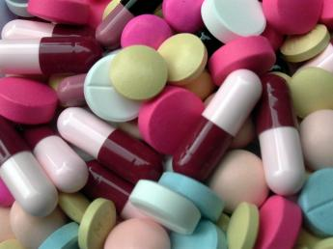
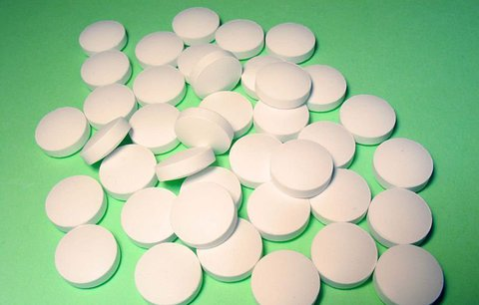
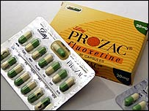
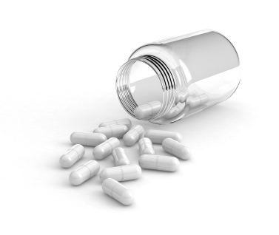
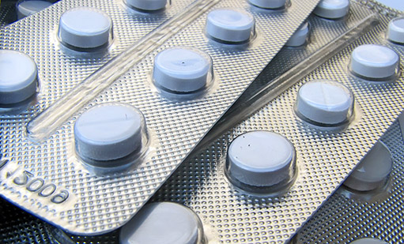
Medicine, pills
People can be addict to pills for example:
Anti-depressants f.e.: prozac, seroxat…
Pills for sleep and others pills
These types of drugs is legal too.

Slide 7
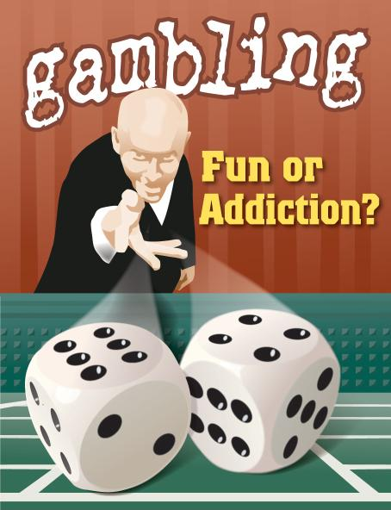
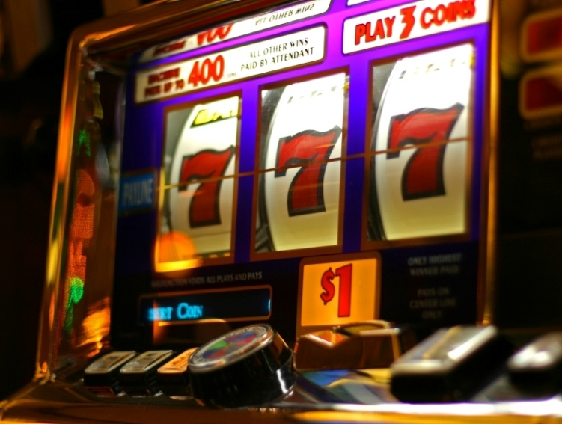
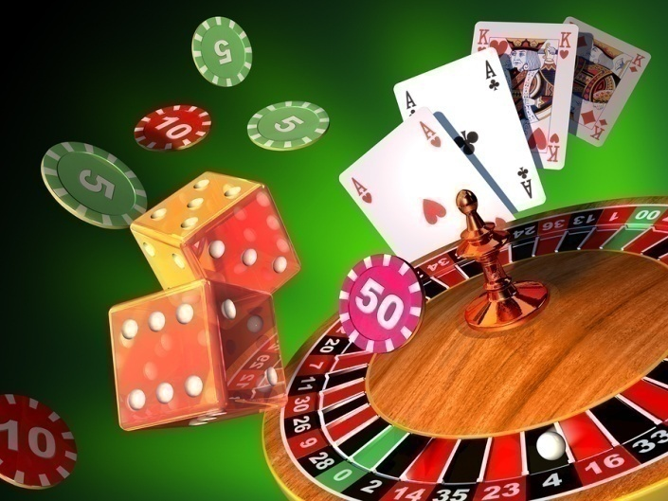
Gambling:
It is specific kind of addiction
Gambling is, when people like (he is addicted) to play hazard games
Gambling can be conect with any others addictions (mostly drugs, alcohol)

Slide 8


What do you think?
Everybody write 3 reasons, why do people take drugs?
Do you have any addiction?

Slide 9
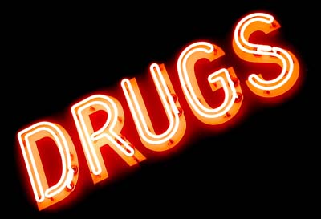
TYPES OF DRUGS:
We have 4 types of drugs:
Get hight (stimulants = uppers)
- cocaine, crack, ecstasy, speed = (methamphetamine, pervitin) tobacco
Calm down (depressants = downers)
- alcohol, cannabis, gases, glues and aerosols, tranquillisers
Trip out (hallucinogenic drugs)
- cannabis, ketamine, LSD and magic mushrooms
Get knocked out (opiate type drugs)
- diacetylmorphine = heroin, morphine, codeine
VOCABULARY:
alert – ostražitý, bdělý, pozorný affect – ovlivnit, postihout
calm – klidný mind - mysl
glues – lepidlo, klih distort – zkreslit
tranquillisers – uklidňující lék, sedativum

Slide 10
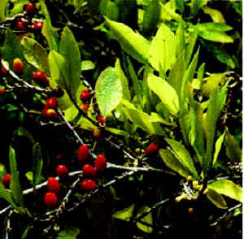
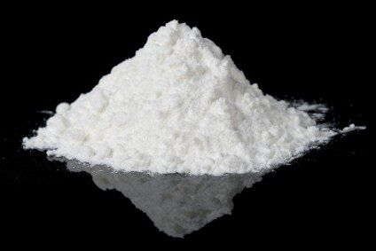
Stimulants = Uppers
Cocaine, Crack – (snow), illegal drugs !!!
- Powder form, crack is in crystal form
- From the leaves of the coca plant
- Increase - alertness, feelings of well-being and euphoria, energy and activity, feelings of competence and sexuality
Form of application:
- Oral - smoking, sniffing=(blowing), chewing coca leaves,
- (Drug injection), crack - inhalation
increase - zvyšovat
alertness – ostražitost
powder – prášek
sniff(snuff or snort) - šňupat
chew - žvýkat

Slide 11
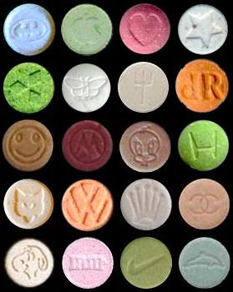
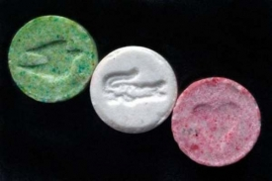
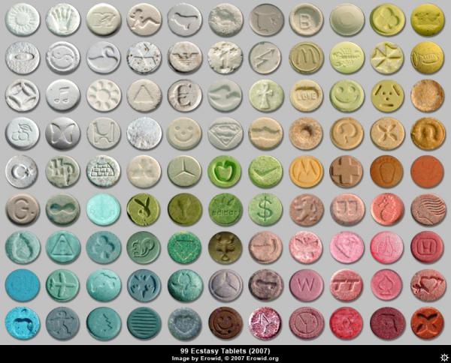
Stimulants = Uppers
Ecstasy – (E, ball, drug (pill) of love)
- Powder form or tablet (pill)
- Many kinds of colors and designs
- Can induse – euphoria and sense of intimacy with others,
love for others, inner peace,
feelings of empathy and forgiveness
- Increase - energy and endurance, motivation, desire
- Diminish - anxiety, fear, aggression and hostility
Form of application: oral
induse – vyvodit, přivolat
inner – vnitřní
forgiveness – odpuštění
increase – zvýšit, přibývat
endurance – výdrž, vytrvalost, odolnost
desire – touha, chuť
diminish – snížit
anxiety – úzkost, strach, obava
hostility - nepřátelství

Slide 12
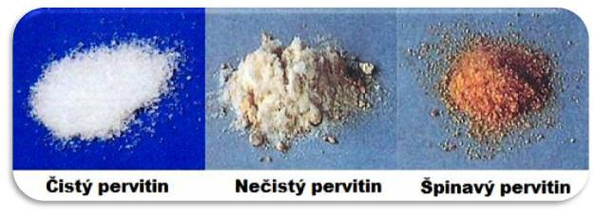
Stimulants = Uppers
Speed = (methamphetamine, pervitin)
Increase - alertness, concentration, energy
Can induce - euphoria
Many negative effects : fatigue, depression, anxiety, headaches, agitation, aggression, deep REM sleep and suicidal ideation, psychotic behaviour
Form – like as small fragment of glass or bright blue-white crystals
Form of application: injection, smoking
Pervitin is the most addictive drug!
Can causes paranoia, hallucinations and even death.
It most worst treatable addiction!!!
increase – zvyšovat anxiety – úzkost, strach behaviour - chování
alertness – ostražitost headaches – bolesti hlavy fragment - úlomek
induce – navodit, vyvodit agitation - rozrušení cause - způsobovat
fatigue – únava, vyčerpání suicidal ideation – sebevražedné sklony
treatable - léčitelný

Slide 13
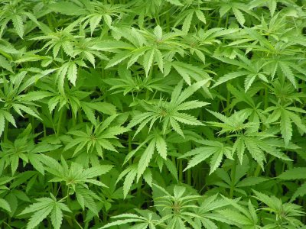
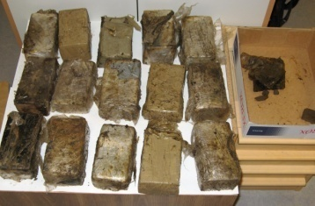
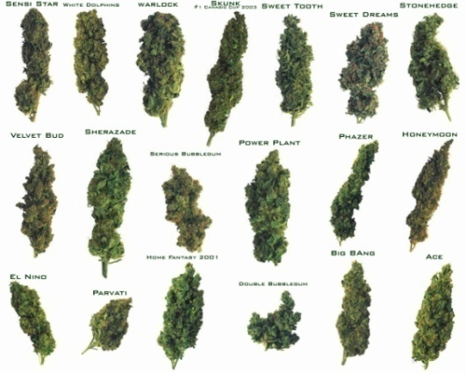
Depressants = Downers
Cannabis – marijuana, grass, skunk = a type of cannabis
(Hashish (hash) – is resin of cannabis plant, usually combinate with cannabis.)
- Downers and hallucinogenic drug
Most famous drug and the most famous illicit drug on the world
Many kinds of this drug
Used as psychoactive drug and as medicine( used for treatment Alzheimer‘s disease)
Main element is THC
Recreational drug, use at religion or spiritual rituals
In the Netherlands this drug is legal and tolerate!
Form of application: mixed with tobacco (joint) and smoked, make a tea – drink, bake hash cakes and cookies – eat, in India cannabis mixed with tobacco - chew
resin – pryskyřice treatment - léčba
illicit – nezákonný, zakázaný main - hlavní

Slide 14
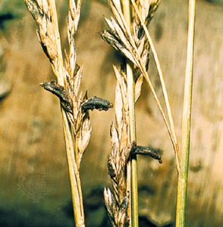
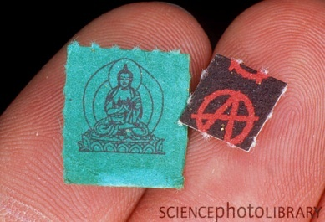
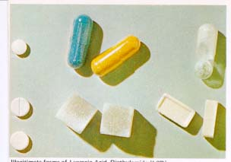
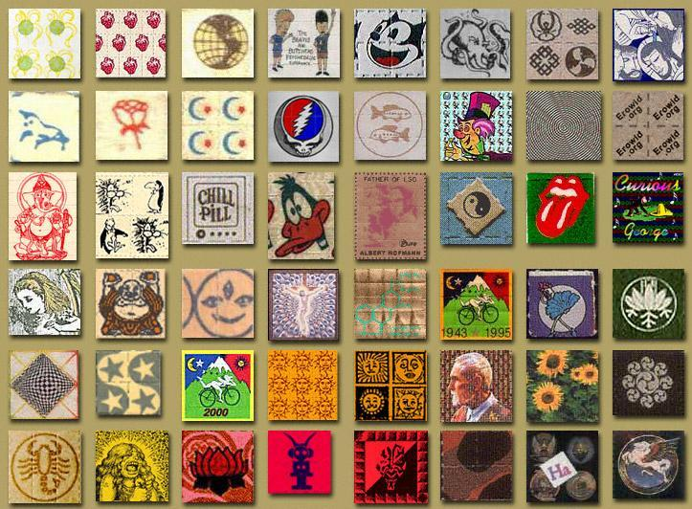
Haluccinogenic drugs
LSD – acid, trip, paper
- Semisynthetic psychedelic drug
- Change consciousness(hallucination, illusion)
- Is a product of poisonous fungus growing on rye
- Effects of this drug are non-predictable
- Can cause to 12 hours
Form – sells in pills or liquid form, LSD is in blotting paper – divide LSD into squares, 1 square is one dose
Form of application: oral
consciousness – vědomí cause – působit
poisonous fungus – jedovatá houba liquid – tekutý (tekutina)
rye – žito blotting paper – savý papír
non-predictable- nepředvídatelný dose - dávka
divide - rozdělit

Slide 15
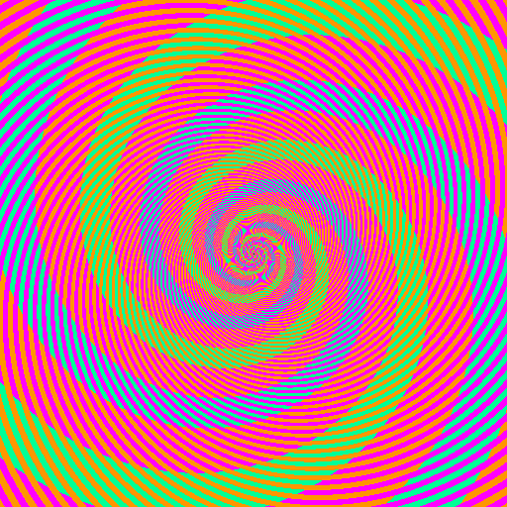
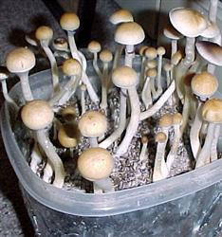
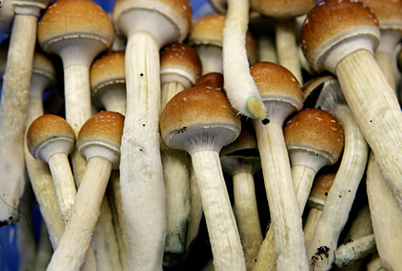
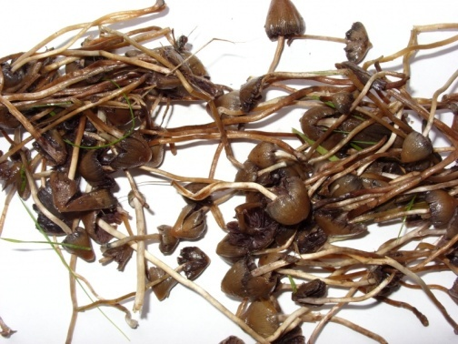
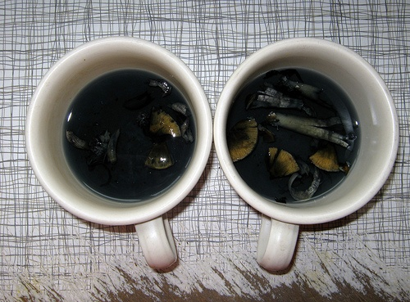
Hallucinogenic drugs
Magic mushrooms – psilocybin mushrooms
- Many kinds (20 kinds in the Czech R.)
- Main psychoactive elements: psilocybin and psilocin
- Used in ancient time, used for religious purposes, rituals
- Psychedelic effects may brings: panic attacks, depression and delusions
Very important is dosage, picking: in October, November
Form of application: eat raw mushrooms,
dried mushrooms mix with cannabis and smoke, drink a tea
contain – obsahovat delusion – klam, myslná představa
purpose – účel dosage – dávkování
raw – syrový dried - sušený

Slide 16
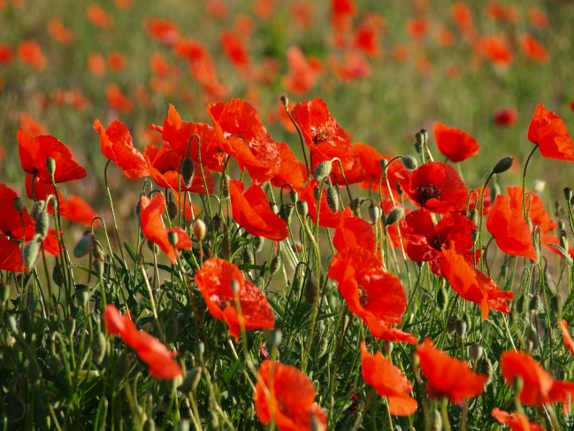
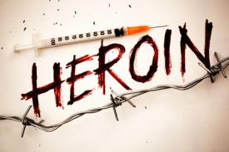
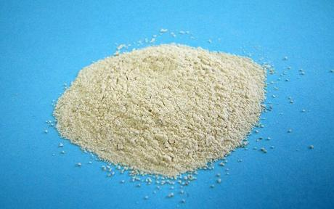
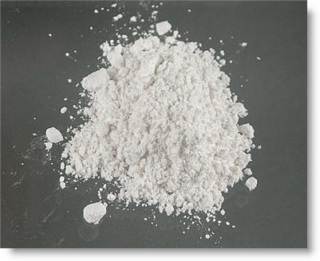
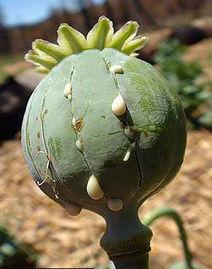
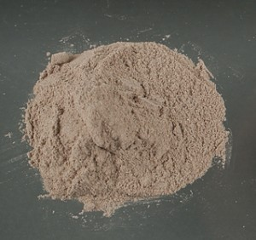
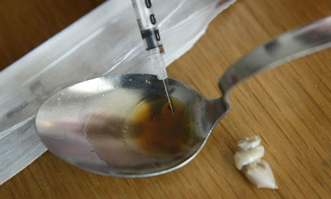
Opiate type drugs
Heroin, (Morphine, Codeine)
- Opiate analgesic, heroin is hard and strong drug
- 15 million users of heroin (15-64 years old)
- Heroin causes immediately (till 6-8 hours)
Effects: relaxing, sleepiness, calming down, no perception of pain
Form of application: smoking, injection
Injection!!! – danger of transfer HIV and hepatitis!
Heroin is usually cause of death!!!
perception – vnímání
pain – bolest
sniffing - šňupání
cause of death – příčina smrti

Slide 17

ORGANIZATIONS:
1) Low-threshold Organizations (nízkoprahové)
- Drop-in – www.dropin.cz
- K-Centrum – www.k-centrum.net
2) Hospitals
- Bohnice – www.plbohnice.cz
- Hradec Králové – www. alkohol-alkoholismus.cz
3) Detox
PL Apolinář, PL Bohnice, PL Brno, PL Plzeň
4) Other Organizations
- Alcoholics Anonymous, Narcotics Anonymous

Slide 18
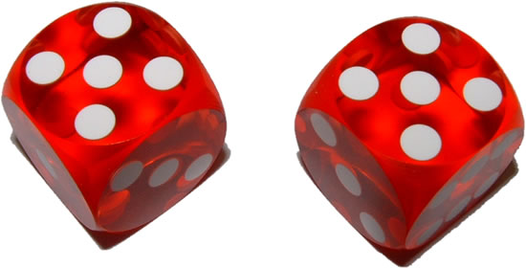
THE GAME

Slide 19
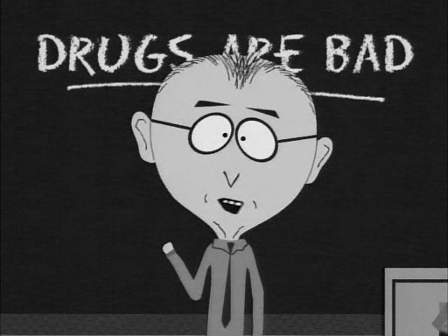
Thank you for your attention !!!

