Slide 1

Children and the Youth

Slide 2
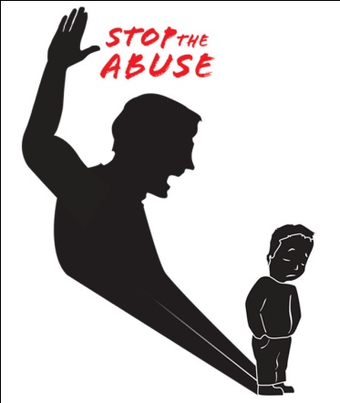
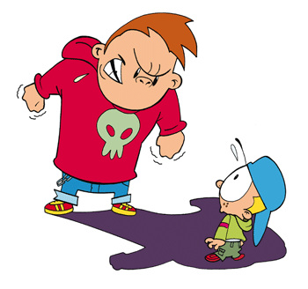
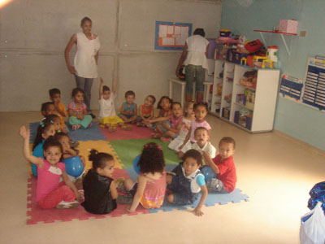
Structure
Children abuse
Bullying
Children‘s social services

Slide 3
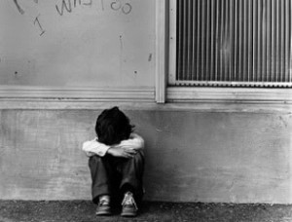
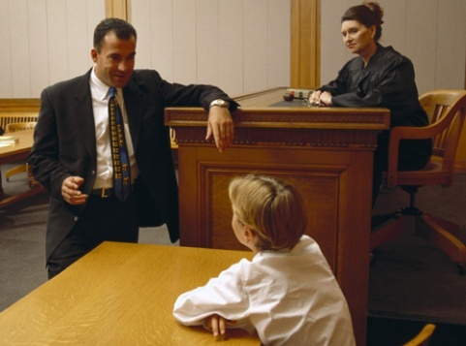
Children Abuse
When can we call it child abuse?
-Physically, sexually, emotionally abuse or being neglected.
Reporting child abuse, what can social services do?
-Police, court or children protection register

Slide 4
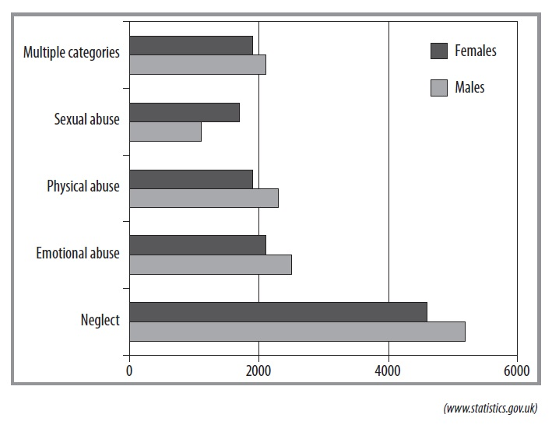
Children on child protection registers in the UK: by sex and category of abuse

Slide 5
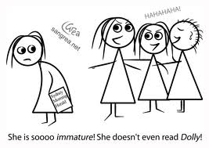
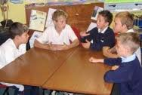
Bully
When can we call it ‚Bully‘?
-Remarks, violence, out of social activities, rumours, cyberbullying
Dealing with Bullyes, what can we do?
-Discuss, keeping rules, individual attitude, breaking group dynamics

Slide 6
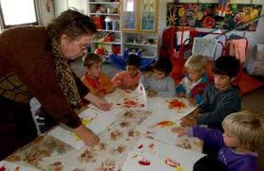
Children‘s social services
Safeguarding and promoting the welfare of children
Supporting looked-after children
Foster carers
Children’s homes
Children and young people leaving care and accommodation
. Out of school childcare

Slide 7
