Slide 1
Addiction

Slide 2
Structure
1.1 Type of drugs and their effects
1.2 Alcohol addiction
1.3 Smoking and nicotine addiction
2.1 How to help
2.2 Activity

Slide 3
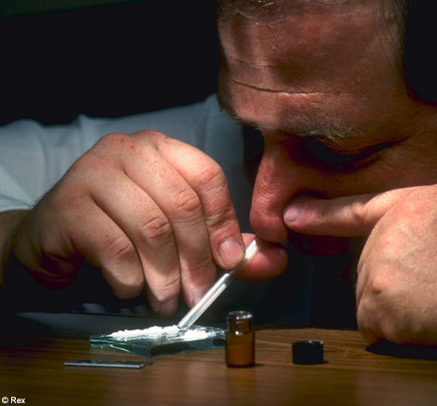
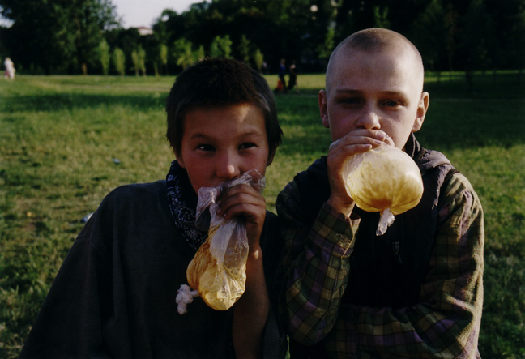
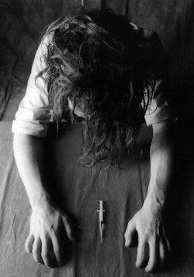

1.1 Type of drugs and their effects
1. Get high
– e.g. cocaine, crack, ecstasy, speed, tobacco.
2. Calm down
– e.g. alcohol, cannabis, gases, glues and aerosols.
3. Trip out
– e.g. cannabis, ketamine, LSD, magic mushrooms.
4. Get knocked out
– e.g. heroin.
2010 – 39 200, cannabis and ecstasy

Slide 4
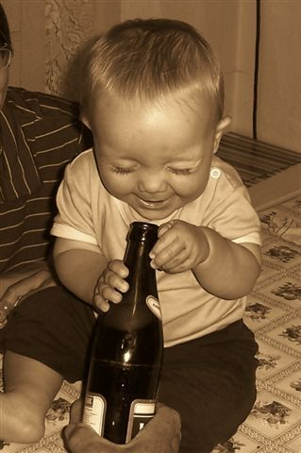
1.2 Alcohol addiction
- effects of many drugs and anaesthetics
- 0,04 per mile of alcohol
- in Czech republic almost 550 000 addicted people (2011)
    25% men, 10% women

Slide 5
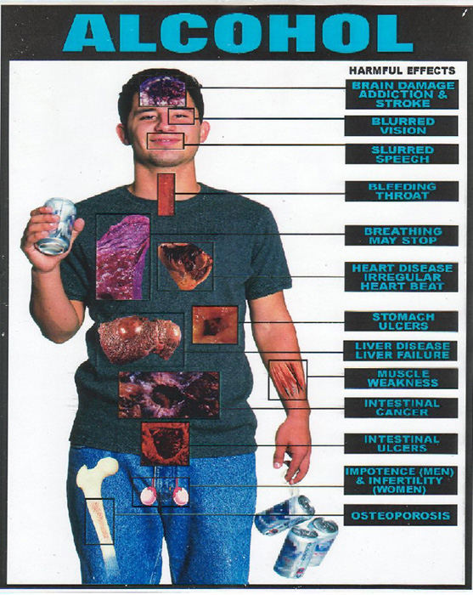

Slide 6
1.3 Smoking and nicotine addiction
rise up very fast – dependece on a subject
withdrawal symptoms
in Czech republic 2 300 000 smokers including 250 000 juveniles

Slide 7
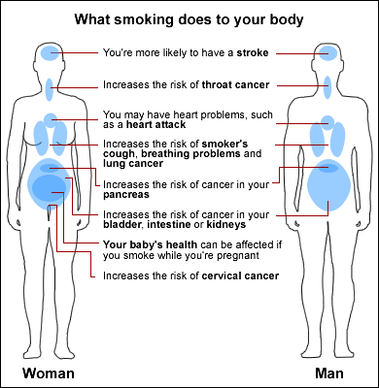
1/3 of tumours
3/4 of chronic lung diseases

Slide 8
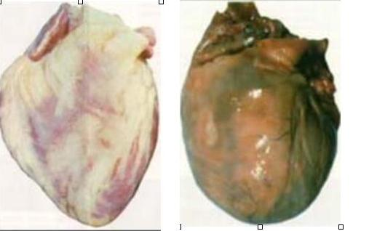
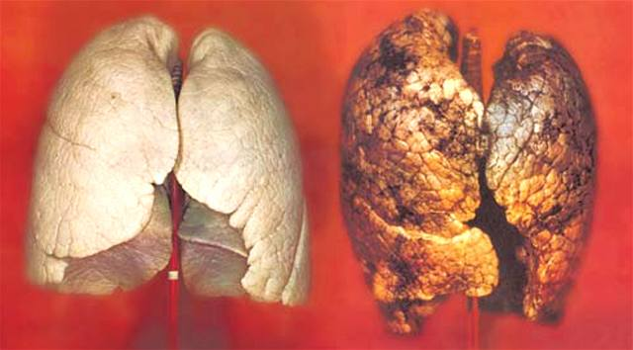

Slide 9
Now you should listen carefully

Slide 10
2.1 How to help
field social work (programs) – Drop-In, SANANIM
drop-in centres, open-access service, low-threshold centres – food and health service
outreach services – greater demands on clients
day care (day hospitals) – intensive, 2–3 months
inpatient detoxification – 5–10 days
psychiatric hospital – residential and rehabilitation service for 3-6 months
therapeutic community –highest demands, 6 – 18 months
aftercare service – drug-related support or non-drug-related support
legal advice
sobering-up station - intoxicated people - one night to become sober
(one night in Opava 700CZK, in Kroměříž 12 700CZK)
another organization for helping people

Slide 11
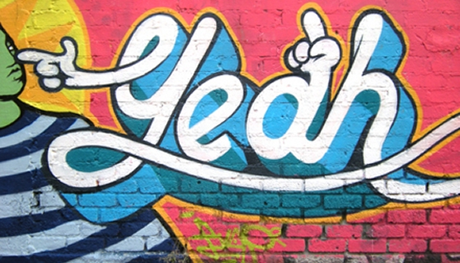
2.2 Activity

Slide 12
The Story
The story is about Sarah, young single mother who was addict. She was found by police officer. She was drugged and she did disturbance. Police officer wanted to find out her identity and take her to sobering-up station. Because she was drugged obviously. Sarah refused to show her ID card and she didn’t want to go to sobering-up station. Sarah had no money there is no way how she could pay for sobering-up station and she left her child alone at home. Sarah had no one who could take care of her child.
Anna is social worker. She is new one in her department and she is full of hope and optimism. Anna has called in Sarah’s case. She believe that Sarah want to change herself because of her baby. In case Sarah lost her child she wouldn’t have any other motivation for overcoming to addiction of drugs.
Anna really trusts Sarah can manage it. Anna wants find a compromise which is not going to be inconsistent with law, ethical code (codex) and wish of client.

Slide 13
Rules
Now we are going to separate you into three groups:
group one is going to represent Sarah, drug addicts
group two – police officers
group three – social workers
Now you will have 5 minutes for discussion in groups. You have to find the best solution for the situation of your group.
E.g. group one - What is Sarah thinking that is the best solution for her.
You can write you arguments and ideas. You can have a leader.
After this you should find the best solution together (discussion between three groups).

Slide 14
How to help
field social work (programs) – Drop-In, SANANIM
drop-in centres, open-access service, low-threshold centres – food and health service
outreach services – greater demands on clients
day care (day hospitals) – intensive, 2–3 months
inpatient detoxification – 5–10 days
psychiatric hospital – residential and rehabilitation service for 3-6 months
therapeutic community –highest demands, 6 – 18 months
aftercare service – drug-related support or non-drug-related support
legal advice
sobering-up station - intoxicated people - one night to become sober
(one night in Opava 700CZK, in Kroměříž 12 700CZK)
another organization for helping people

Slide 15

Thx for your attention

