Slide 1
Refugees footprints

Slide 2
Table of content
Definition of refugees
Environmental refugees
Economic migrants
Help for refugees
Asylum seekers
The safety
Human rights
Ways to better life

Slide 3
Definition of refugees
„A person who is outside his or her country of nationality…has fear of persecution of his or her race, religion, nationality; and is unable to…return there for fear of persecution.“
They leave their homes and their country because they have no other choice.
Factors – war, persecution, natural disasters, environmental crises, poverty, no human rights
Places – Palestine, Afghanistan and Iraq

Slide 4
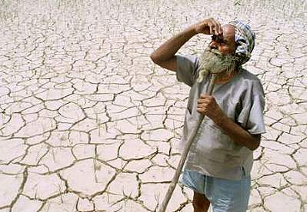
Environmental refugees
People forced to leave their homes because of environmental factors are considered a new type of refugee.
Factors – rising sea levels, soil erosion, lack of freshwater supplies,
Places – mostly Africa, Asia, India

Slide 5
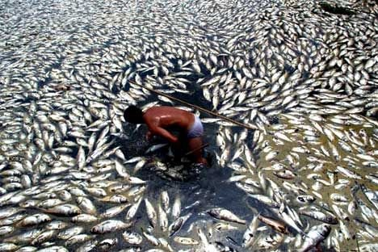
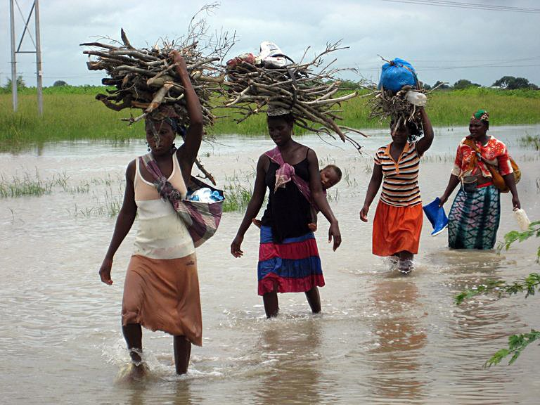
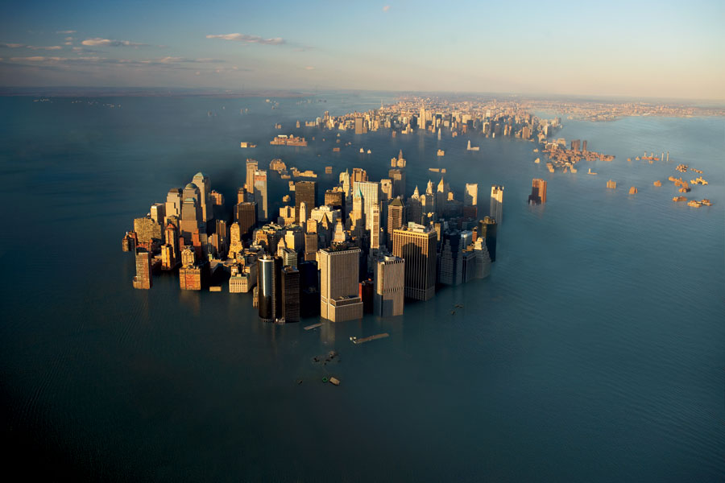

Slide 6
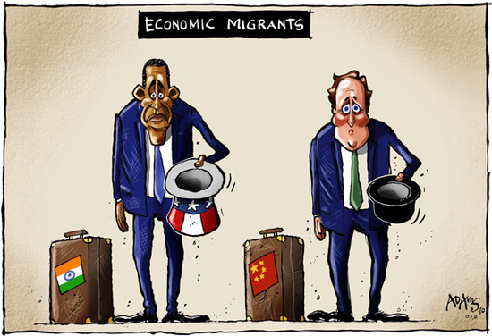
Economic migrants
People who normally leave their homes and countries voluntarily to seek a better life elsewhere.

Slide 7
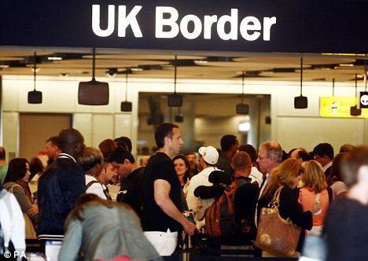

Slide 8
So do you know what are the differences between refugees and emigrants?
?

Slide 9
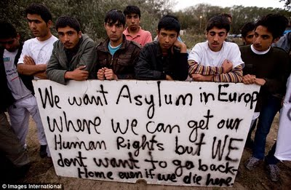
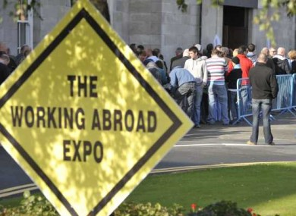
Answer
Refugees – flee their homes because of the threat of PERSECUTION
Economic migrants – can return home when they choose to, will not face the threat of persecution.

Slide 10
Where refugees can find help?
UNHCR (The United Nations High Commissioner for Refugees)
Special agenture responsible for assisting refugees (to protect them and solve their problems)
How do they help?
With seeking asylum
Finding place of safety in another state

Slide 12
Problems of asylum seekers
They are turned away at country borders
Why?
Right identification
Travel documents
Applying for refugees status

Slide 13
Are they safe after they leave their home?
Live is never easy for them
Why?
Bad memories of past experiences
Separating from family and friends
Get used to on life in a new country (language, job)

Slide 14
Refugees and human rights
Human rights are abused
Every refugee has the right to safe asylum
Child refugees – rights are denied
Separating from family
Mistreating
Abusing
Forcing them to work in dangerous environment

Slide 15
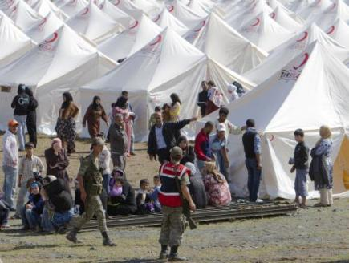
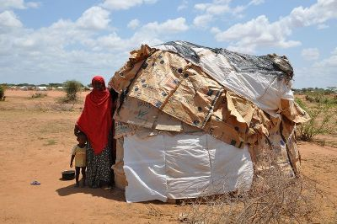

Slide 16
Three ways for better life of refugees and asylum seekers
1) Governments need to consider actions which are forcing people to leave their home!
2) Safety in another country needs to be improve!
They need financial support – health care, education
3) The same conditions for rich and poor people!

Slide 17
Thank you for your attention!

