Slide 1
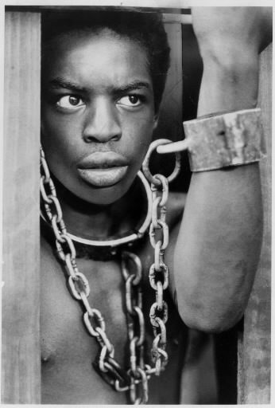
Racism

Slide 2
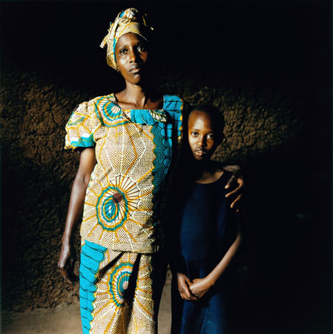
Table of content
Carol
Petra
Definition of racism
Two groups of racism
High time of racism
Rwanda
  where
  when
  what
  testimonies

Slide 3
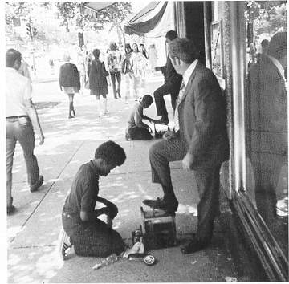
Precise definition of racism in wikipedia:
Racism is generally understood as either belief that different racial groups are characterized by intrinsic characteristics or abilities and that some such groups are therefore naturally better to others or as practices that discriminate against members of particular racial groups.

Slide 4

Racism
Two groups of racism
Creation
                Gentle racism
                hard racism
Racism was born in the age of romanticism (eighteenth century) because of enlightenment theories of civil equality in connection ethnic nationalism.
The first big name of rasism is in the age of slavery. (Roma, South America, Izrael, etc.)

Slide 5
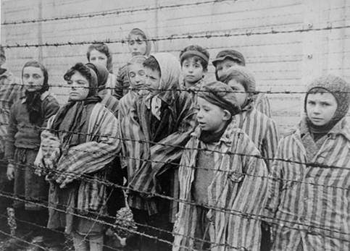
High time racism
The age of the second world war is considered as the high time of racism. Racism was work there as the most powerfull nazi propaganda technique. In this war died sixty milions people. In nazi doctrine about races was jewish race considered as the bigest danger so nazis wanted to destroy jewish race. Jews were sent to concentration camps and there were destroied. The main representative of nacism was Adolf Hitler.

Slide 6
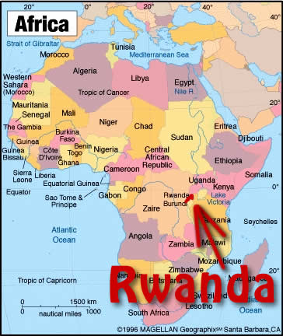
Racism in Rwanda

Slide 7
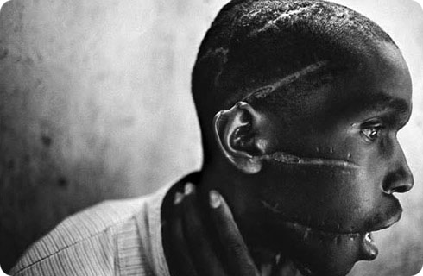
During 100 days were killed
1 000 000 people
1994
tutsis and hutus tribes
20% of human population
250 – 500 000 woman raped
And what exactly happedned ?
http://www.youtube.com/watch?v=tdV1mhFPWXo&feature=related

Slide 8
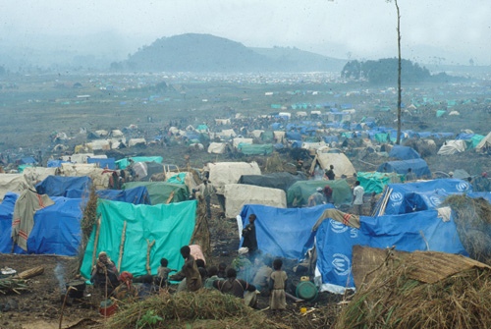
Rwandan refugee camp in east Zaire

Slide 9
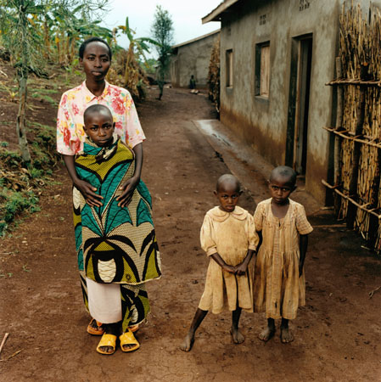
Rwanda testimonies
http://www.youtube.com/watch?v=a-auO4EmQVI&feature=related
http://www.foundationrwanda.org/testimonies/brigitte.aspx

